Slide 1
Topic05.Feature reduction selection/extraction
資料科學 Data Science
張家銘 Jia-Ming Chang
政治大學資訊科學系
The slide isonly for educational purposes. If any infringement, please contact me and we will correct immediately.

Slide 2
Copyright declaration 版權說明
Some of the figures in this presentation are taken from "An Introduction to Statistical Learning, with applications in R" (Springer, 2013) with permission from the authors: G. James, D. Witten, T. Hastie and R. Tibshirani.
The web site of the book
The credit of individual is indicated in the bottom part of the slide.
ie.,

Slide 3

Copyright declaration 版權說明
Some of the figures in this presentation are taken from "Practical Data Science with R (Manning, 2019)”
The web site of the book
The credit of individual is indicated in the bottom part of the slide.
ie.,

Slide 4
Copyright declaration 版權說明
Some of the figures in this presentation are taken from "R for Data Science” under the Creative Commons Attribution-NonCommercial-NoDerivs 3.0 License.
The web site of the book
The credit of individual is indicated in the bottom part.
ie.,

Slide 5
Recap for the last week

Slide 6
Bias-variance decomposition
E[(y[i]-f(x[i,]))²] = bias² + variance + irreducibleError
Model bias : your chosen modeling technique will never get right
Model variance : your modeling technique gets wrong due to incidental relations in the data.
Irreducible error : truly unmodelable portion of the problem given the current variables

Slide 7
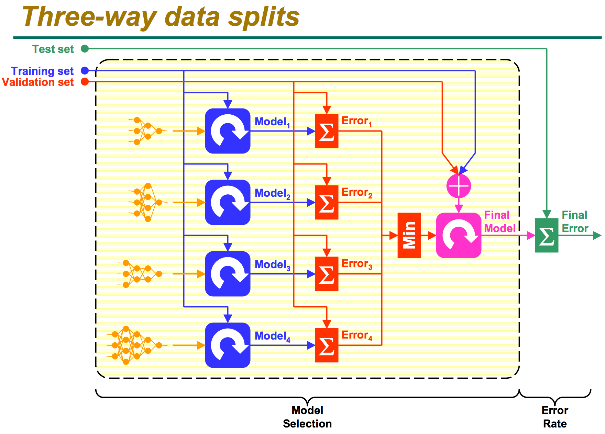
Three-way data splits
http://research.cs.tamu.edu/prism/lectures/iss/iss_l13.pdf

Slide 8
Summarizing R’s distribution naming conventions
dDIST(x, ...)
the distribution function (PDF) that returns the probability of observing the value x.
rDIST(n, ...)
the random number generation function that returns n values drawn from the distribution DIST.
qDIST(p, ...)
the quantile function that returns the x corresponding to the pth percentile of DIST.
pDIST(x, ...)
the cumulative distribution function (CDF) that returns the probability of observing a value less than x.
Practical Data Science with R by Nina Zumel, John Mount

Slide 9
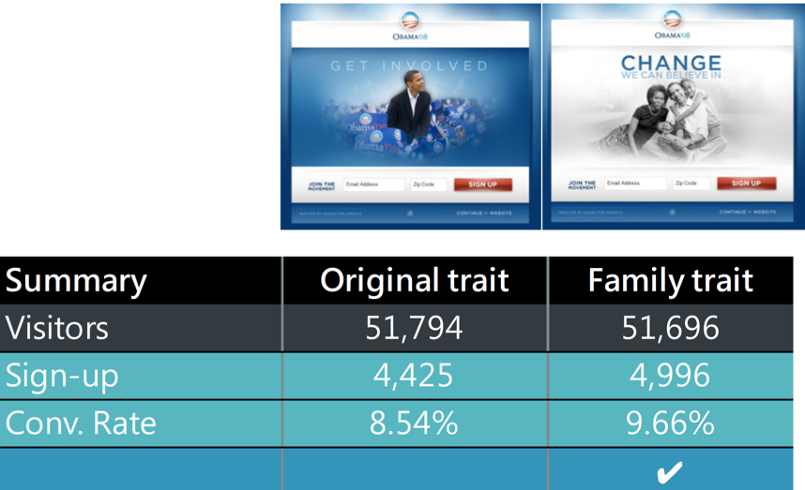
Significance testing
null hypothesis D = (err.null - err.model) == 0
p-value is the probability of null hypothesis
p < 0.05 => reject the null hypothesis

Slide 10
A/B test
Fisher’s test for independence
the null hypothesis : conversion is independent of group , A=B
fisher.test(tab)
Frequentist significance test
assume that A and B come from an identical distribution with a common conversion rate => how likely it would be that the B group scores as high as it did by mere chance!
Practical Data Science with R by Nina Zumel, John Mount

Slide 11
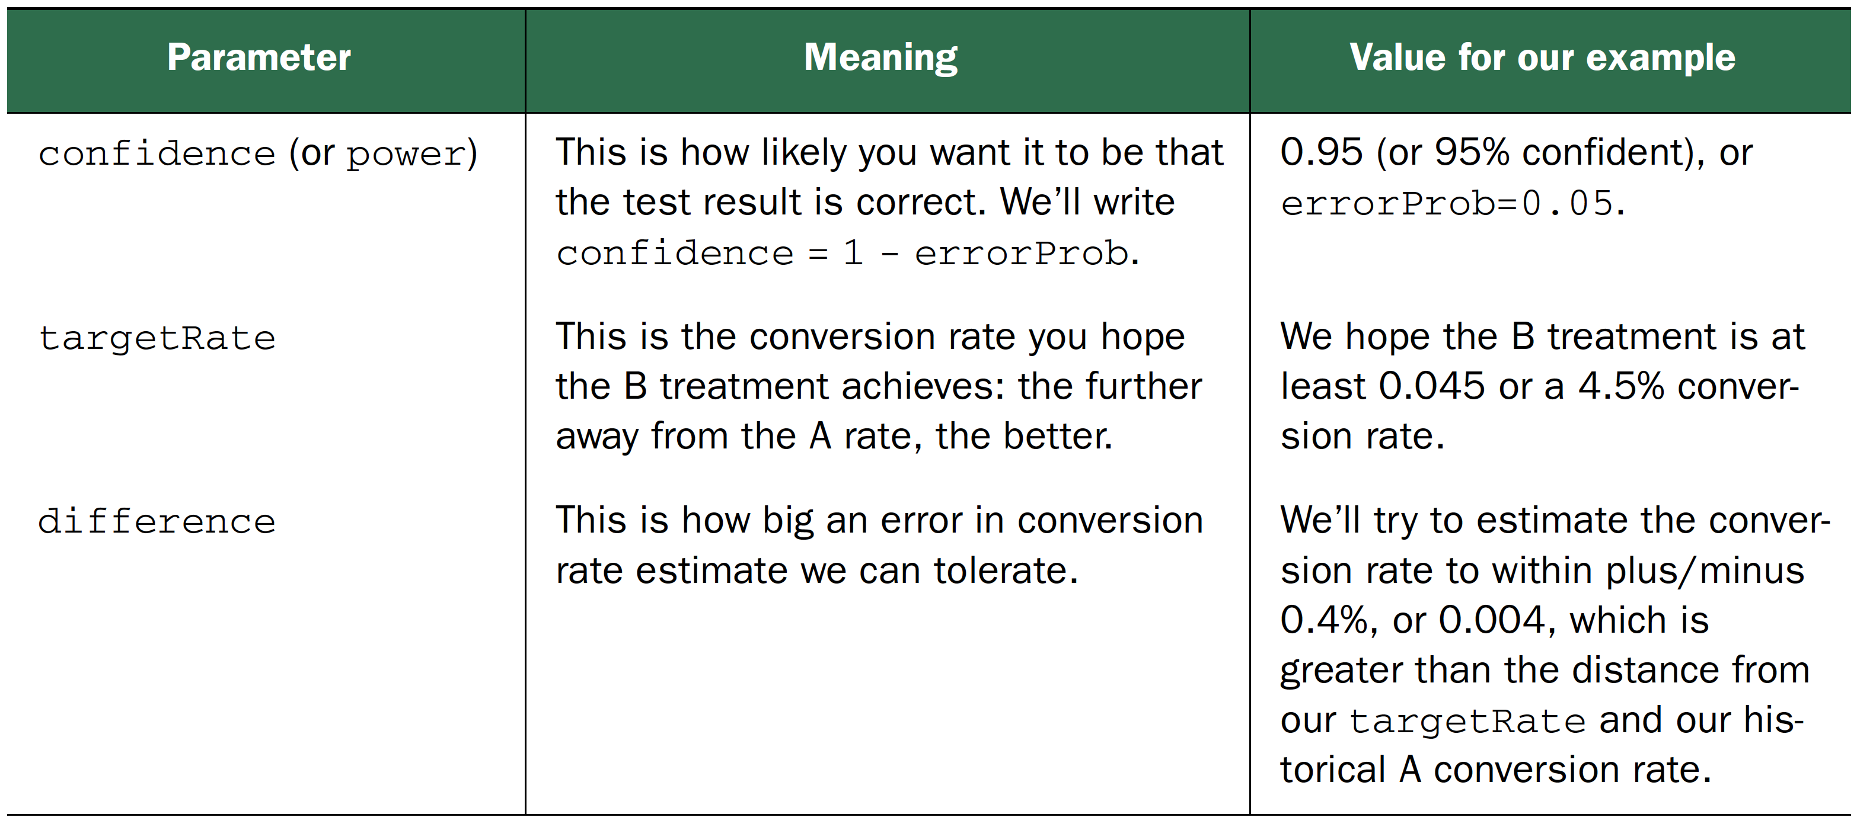
Statistical test power
probability of rejecting the null hypothesis when the null hypothesis is false = 1 - p-value
seeing a B conversion rate in the range of 4.1–4.9% if the true B conversion rate were in fact 4.5% => how many customers to the B treatment?
Practical Data Science with R by Nina Zumel, John Mount

Slide 12
Sample size estimate
estimate <- function(targetRate,difference,errorProb) {
ceiling(-log(errorProb)*targetRate/(difference^2))
}
(est <- estimate(0.045,0.004,0.05))
We need about 8,426 visitors to have a 95% chance of observing a B conversion rate of at least 0.041 if the true unknown B conversion rate is at least 0.045.
Practical Data Science with R by Nina Zumel, John Mount

Slide 13
Design experiments
estimate <- function(targetRate,difference,errorProb)
estimate(0.045,0.004,0.05)
Performance difference vs confidence
measure large performance differences with high confidence
estimate(0.045,0.005,0.04)
measure small performance differences with even moderate confidence.
estimate(0.045,0.003,0.06)
Practical Data Science with R by Nina Zumel, John Mount

Slide 14
Exact binomial sample size calculation
We need about 8,426 visitors to have a 95% chance of observing a B conversion rate of at least 0.041 if the true unknown B conversion rate is at least 0.045.
pbinom(ceiling((0.045-0.04)* 8426), size= 8426, prob=0.045)
The failure odds are around 4% (under the 5% we’re designing for), which means the estimate size was slightly high.
Practical Data Science with R by Nina Zumel, John Mount

Slide 15
Venue shopping reduces test power
multiple tests : if you run 20 treatments, each with a p-value goal of 0.05, you would expect one test to appear to show significant improvement, even if all 20 treatments are useless
p cutoff: p / the # of tests you intend to run
Practical Data Science with R by Nina Zumel, John Mount

Slide 16
Feature reduction

Slide 17
Feature reduction
Feature selection
select the most influential features from the feature set => improve the recognition rate as well as reduce the computation load
Feature extraction
find a linear transformation to transform the original feature vector into a new one => maximize the separation between different classes
Credit : Roger Jang (張智星), Data Clustering and Pattern Recognition (資料分群與樣式辨認)

Slide 18
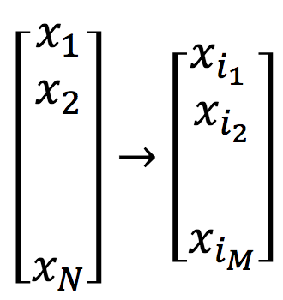
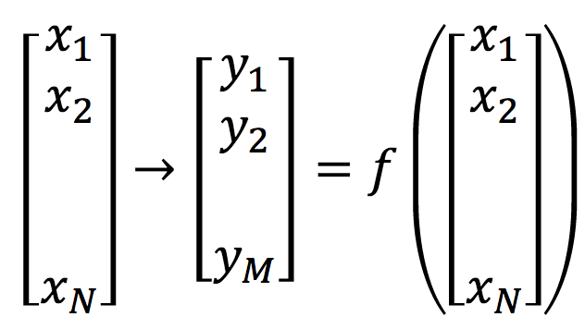
Feature extraction vs. feature selection
Feature extraction: Transform the existing features into a lower dimensional space
Feature selection: Select a subset of the existing features without a transformation
Credit : CSCE 666 Pattern Analysis | Ricardo Gutierrez-Osuna | CSE@TAMU

Slide 19
Feature selection

Slide 20
Feature Selection: Goal & Benefits
Goal
To select a subset out of the original feature set for better prediction accuracy
Benefits
Improve recognition rate
Reduce computation load
Explain relationships between features and classes
Credit : CSCE 666 Pattern Analysis | Ricardo Gutierrez-Osuna | CSE@TAMU

Slide 21
Exhaustive Search
Steps for direct exhaustive search
Use k-nearnest neighboring classifier (KNNC) as the classifier, leave-one-out (LOO) test for R² estimate
Generate all combinations of features and evaluate them one-by-one
Select the feature combination that has the best R².
Credit : CSCE 666 Pattern Analysis | Ricardo Gutierrez-Osuna | CSE@TAMU

Slide 22
Exhaustive Search
Direct exhaustive search
1 input
x1
x2
x3
x4
x5
x1, x2
x1, x3
x1, x4
x1, x5
x2, x3
.
.
.
2 inputs
x1, x2, x3
x1, x2, x4
x1, x2, x5
x1, x3, x4
.
.
.
3 inputs
4 inputs
x1, x2, x3, x4
x1, x2, x3, x5
x1, x2, x4, x5
.
.
.
Credit : CSCE 666 Pattern Analysis | Ricardo Gutierrez-Osuna | CSE@TAMU

Slide 23
Exhaustive Search
Drawback
Time consuming
d features => 2^{d}-1 procedures for performance evaluation
d = 10 ➔ 1023 CV for evaluation
Advantage
The optimal feature set can be identified.
Credit : CSCE 666 Pattern Analysis | Ricardo Gutierrez-Osuna | CSE@TAMU

Slide 24
Exhaustive Search
Characteristics of exhaustive search for feature selection
The process is time consuming, but the identified feature set is optimum.
It’s possible to use classifiers other than KNNC.
It’s possible to use performance indices other than LOO.
Credit : CSCE 666 Pattern Analysis | Ricardo Gutierrez-Osuna | CSE@TAMU

Slide 25
Heuristic Search
Heuristic search for input selection
One-pass ranking
Sequential forward selection
Generalized sequential forward selection
Sequential backward selection
Generalized sequential backward selection
‘Add m, remove n’ selection
Generalized ‘add m, remove n’ selection
Credit : CSCE 666 Pattern Analysis | Ricardo Gutierrez-Osuna | CSE@TAMU

Slide 26
Sequential Forward Selection
Steps for sequential forward selection
Use KNNC as the classifier, LOO for R² estimate
Select the first feature that has the best R².
Select the next feature (among all unselected features) that, together with the selected features, gives the best R².
Repeat the previous step until all features are selected.
Credit : CSCE 666 Pattern Analysis | Ricardo Gutierrez-Osuna | CSE@TAMU

Slide 27
Sequential Forward Selection
1 input
x1
x2
x3
x4
x5
2 inputs
x2, x1
x2, x3
x2, x4
x2, x5
3 inputs
x2, x4, x1
x2, x4, x3
x2, x4, x5
4 inputs
x2, x4, x3, x1
x2, x4, x3, x5
Credit : CSCE 666 Pattern Analysis | Ricardo Gutierrez-Osuna | CSE@TAMU

Slide 28
Sequential Forward Selection
Advantage
A lot more efficient
d features, we need to perform d(d+1)/2 CV
Drawback
The selected features are not always optimal.
Credit : CSCE 666 Pattern Analysis | Ricardo Gutierrez-Osuna | CSE@TAMU

Slide 29
Use of Input Selection
Common use of input selection
Increase the model complexity sequentially by adding more inputs
Select the model that has the best test RR
Typical curve of error vs. model complexity
Determine the model structure with the least test error
Optimal structure
Error rate
Test error
Training error
Model complexity (# of selected inputs)
Credit : CSCE 666 Pattern Analysis | Ricardo Gutierrez-Osuna | CSE@TAMU

Slide 30
how would a given example score differently if it had different attributes?
Local interpretable model-agnostic explanations for explaining model predictions

Slide 31
iris example
A dataset of petal and sepal measurements for three varieties of iris.
The object is to predict whether a given iris is a setosa based on its petal and sepal dimensions.
4 measurements
sepal length
sepal width
petal length
petal width
3 different species
Setosa
versicolor
virginica
Credit by https://www.math.umd.edu/~petersd/666/html/iris_pca.html

Slide 32
Loading the iris dataset : LIME.R
iris <- iris
iris$class <- as.numeric(iris$Species == "setosa")
set.seed(2345)
intrain <- runif(nrow(iris)) < 0.75
train <- iris[intrain,]
test <- iris[!intrain,]
head(train)
## Sepal.Length Sepal.Width Petal.Length Petal.Width Species class
## 1 5.1 3.5 1.4 0.2 setosa 1
## 2 4.9 3.0 1.4 0.2 setosa 1
## 3 4.7 3.2 1.3 0.2 setosa 1
## 4 4.6 3.1 1.5 0.2 setosa 1
## 5 5.0 3.6 1.4 0.2 setosa 1
## 6 5.4 3.9 1.7 0.4 setosa 1
Credit by Chapter 6.3, Practical Data Science with R by Nina Zumel, John Mount

Slide 33
Fitting a XGBOOST model to the iris training data
source("lime_iris_example.R")
input <- as.matrix(train[, 1:4])
model <- fit_iris_example(input, train$class)
Credit by Chapter 6.3, Practical Data Science with R by Nina Zumel, John Mount

Slide 34
Building a LIME explainer from the model and training data
library(lime)
explainer <- lime(train[,1:4],
model = model,
bin_continuous = TRUE,
n_bins = 10)
Credit by Chapter 6.3, Practical Data Science with R by Nina Zumel, John Mount

Slide 35
Explaining the iris example
(example <- test[5, 1:4, drop=FALSE])
explanation <- lime::explain(example,
explainer,
n_labels = 1,
n_features = 4)
plot_features(explanation)
Credit by Chapter 6.3, Practical Data Science with R by Nina Zumel, John Mount

Slide 36
More iris examples
(example <- test[c(13, 24), 1:4])
test$class[c(13,24)]
explanation <- explain(example,
explainer,
n_labels = 1,
n_features = 4,
kernel_width = 0.5)
plot_features(explanation)
Credit by Chapter 6.3, Practical Data Science with R by Nina Zumel, John Mount

Slide 37
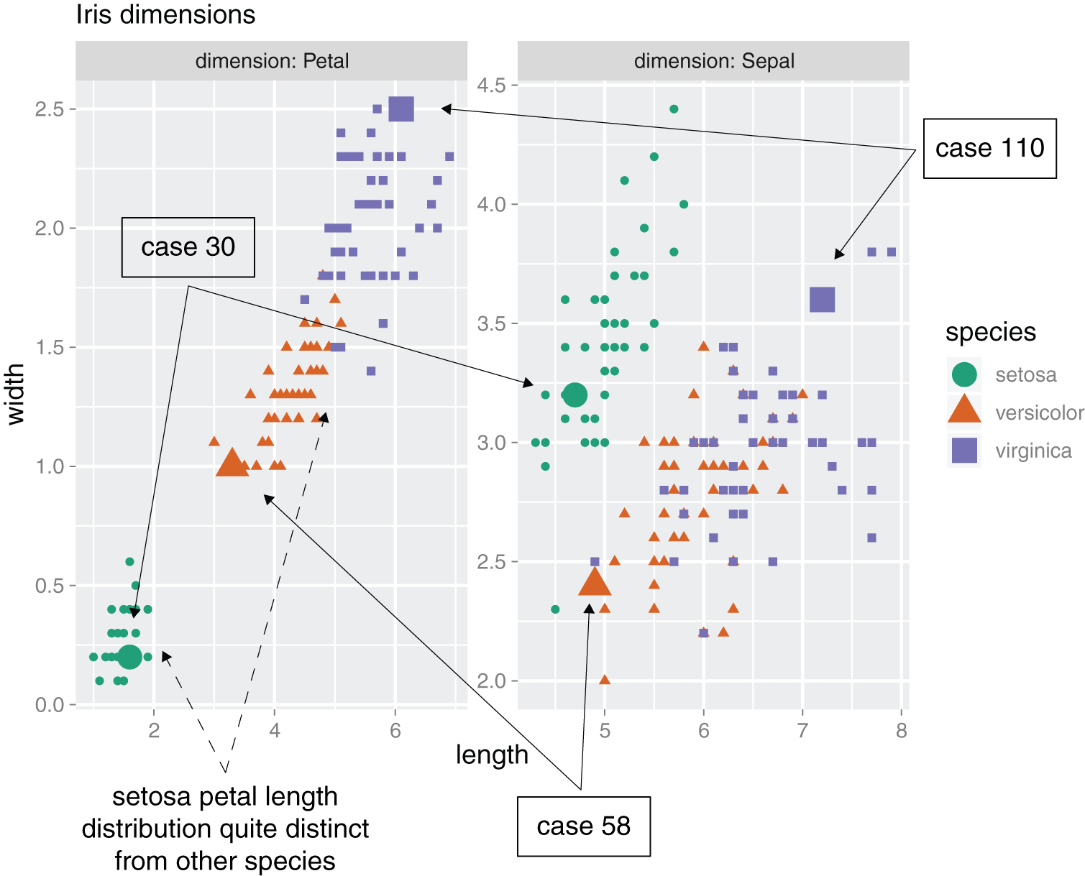
Distributions of petal and sepal dimensions by species
Credit by Figure 6.25, Practical Data Science with R by Nina Zumel, John Mount

Slide 38
How does LIME work?

Slide 39
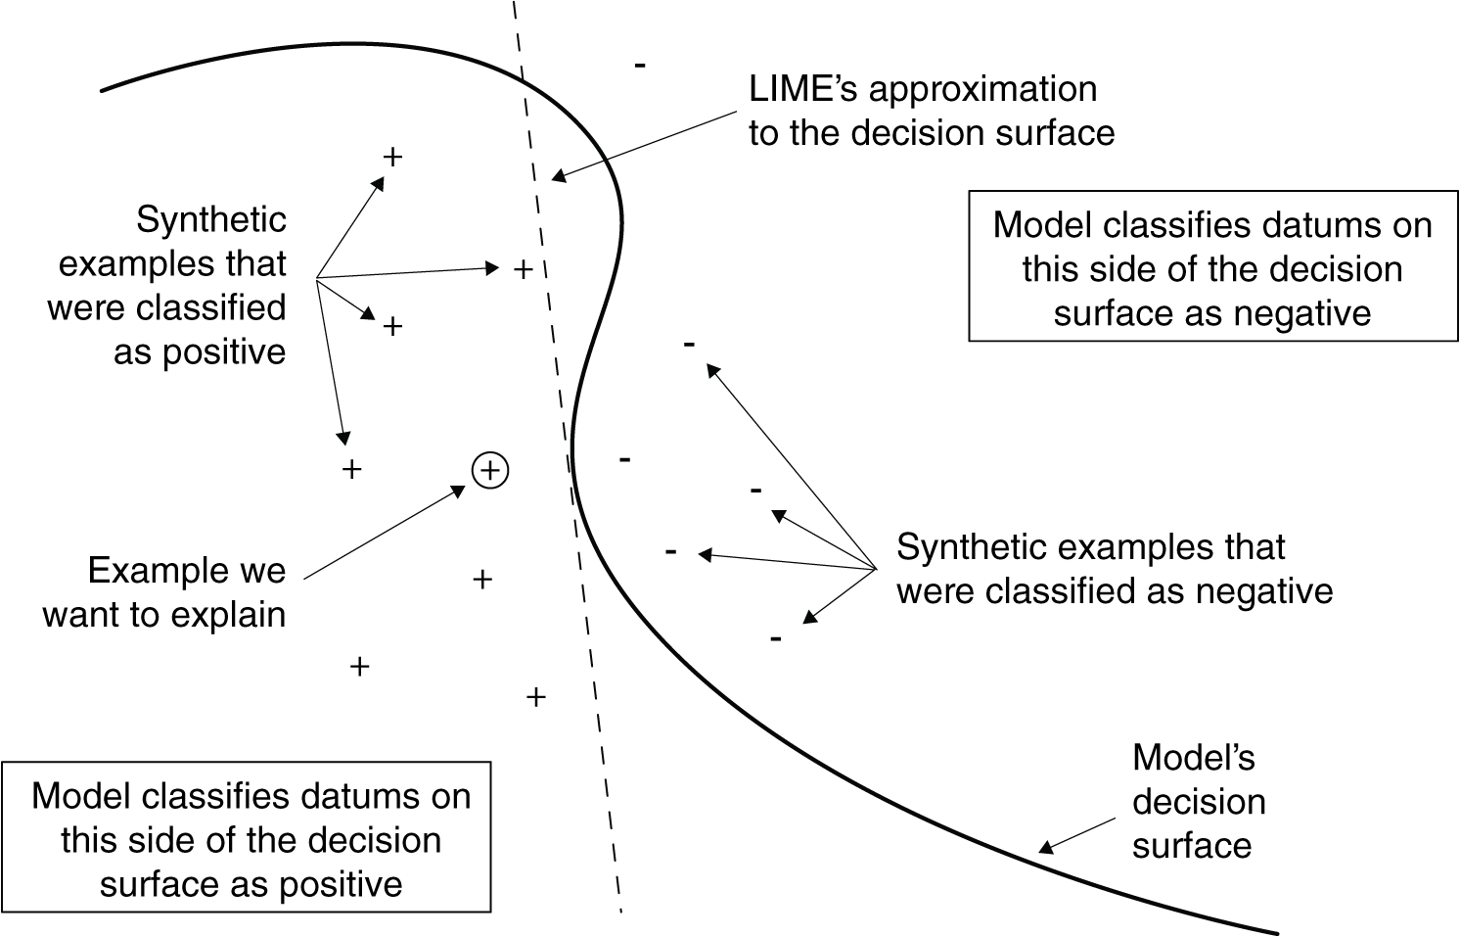
Notional sketch of how LIME works
Credit by Figure 6.23, Practical Data Science with R by Nina Zumel, John Mount

Slide 40
synthetic data points
Original data point
Sepal.Length Sepal.Width Petal.Length Petal.Width
5.1 3.5 1.4 0.2
a jittered point
Sepal.Length Sepal.Width Petal.Length Petal.Width
5.505938 3.422535 1.3551 0.4259682
Credit by Chapter 6.3, Practical Data Science with R by Nina Zumel, John Mount

Slide 41
The model’s decision surface
LIME’s estimate of the decision surface near the example we are trying to explain.
Fit an m-dimensional linear model for {y_i} as a function of {s_i}. The linear model is LIME’s estimate of the original model’s decision surface near example (a dashed line).
Credit by Chapter 6.3, Practical Data Science with R by Nina Zumel, John Mount

Slide 42
Feature extraction

Slide 43
10. Unsupervised Learning 10.2 Principal Components Analysis

Slide 44
Feature extraction
We wish to visualize n observations with measurements on a set of p features, X₁,X₂, . . ., X_{p}, as part of an exploratory data analysis.
We could do this by examining two-dimensional scatterplots of the data.
A two-dimensional representation of the data that captures most of the information, then we can plot the observations in this low-dimensional space.
An Introduction to Statistical Learning with Applications in R by Gareth James, Daniela Witten, Trevor Hastie, Robert Tibshirani

Slide 45
Feature extraction
a best choice of axes – shows most variation in the data.
Found by linear algebra: Singular Value Decomposition (SVD)
True plot in k dimensions
Reduced-dimensionality plot
Notes:
LSI for dimension reduction
Similar to SVD

Slide 46
Principal Component Analysis (PCA)

Slide 47
Principal Component Analysis (PCA)
An effective method for reducing dataset dimensions while keeping spatial characteristics as much as possible
Characteristics
For unlabeled data
A linear transform with solid mathematical foundation
Applications
Line/plane fitting
Face recognition
Many many more...
Credit : CSCE 666 Pattern Analysis | Ricardo Gutierrez-Osuna | CSE@TAMU

Slide 48
What are principal components?
PCA seeks a small number of dimensions that are as interesting as possible
the concept of interesting = the amount that the observations vary along each dimension.
Dimensions found by PCA is a linear combination of the p features
An Introduction to Statistical Learning with Applications in R by Gareth James, Daniela Witten, Trevor Hastie, Robert Tibshirani

Slide 49
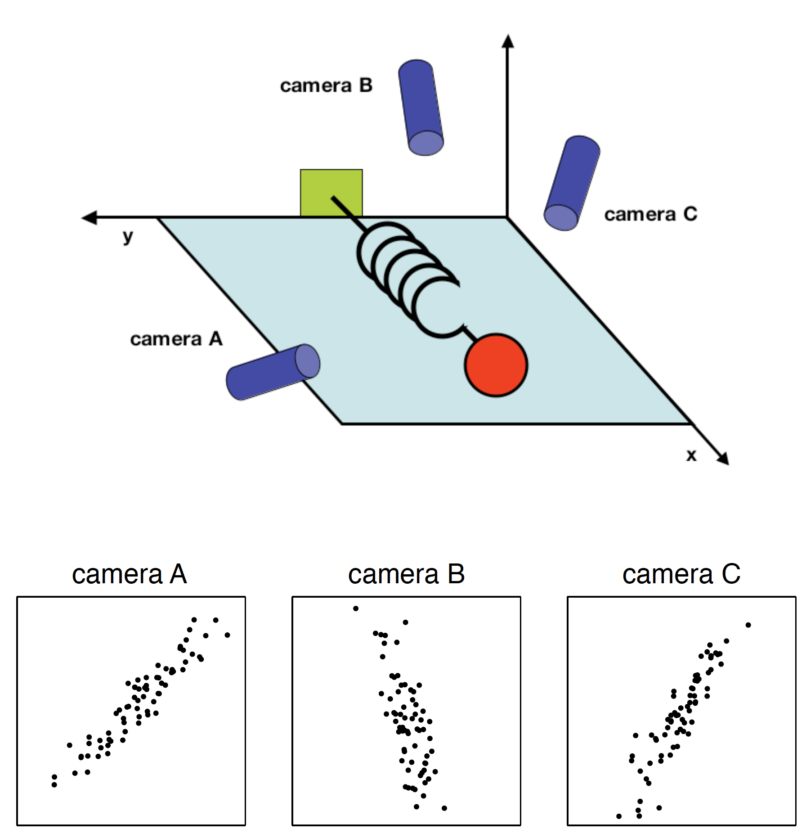
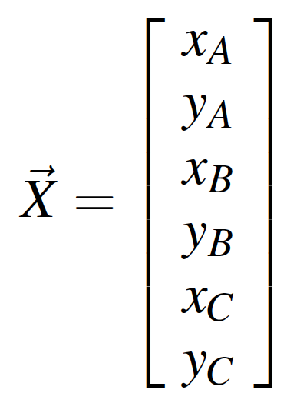
A toy example for PCA
Is there another basis, which is a linear combination of the original basis, that best re-expresses our data set?
Credit: A Tutorial on Principal Component Analysis, Jonathon Shlens

Slide 50
Change of Basis
X : be the original data set, m x n
m features
n points
P : linear transformation
Y : a new representation of that data set
Credit: A Tutorial on Principal Component Analysis, Jonathon Shlens

Slide 51
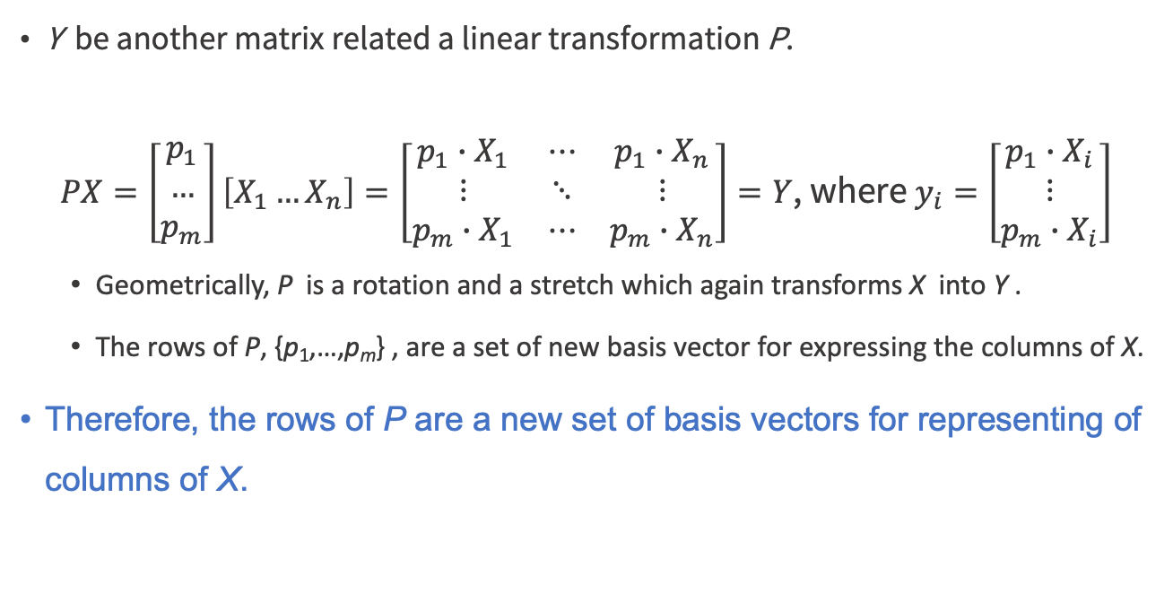
Change of Basis
Y be another matrix related a linear transformation P.
$PX=\left[\begin{matrix}p_{1} \\ … \\ p_{m}\end{matrix}\right]\left[X_{1}…X_{n}\right]=\left[\begin{matrix}p_{1}∙X_{1} & ⋯ & p_{1}∙X_{n} \\ ⋮ & ⋱ & ⋮ \\ p_{m}∙X_{1} & ⋯ & p_{m}∙X_{n}\end{matrix}\right]=Y$, where $y_{i}=\left[\begin{matrix}p_{1}∙X_{i} \\ ⋮ \\ p_{m}∙X_{i}\end{matrix}\right]$
Geometrically, P is a rotation and a stretch which again transforms X into Y .
The rows of P, {p₁,…,p_{m}} , are a set of new basis vector for expressing the columns of X.
Therefore, the rows of P are a new set of basis vectors for representing of columns of X.
Credit: A Tutorial on Principal Component Analysis, Jonathon Shlens

Slide 52
What is the best way to re-express X?
What is a good choice of basis P?
Two key points
Noise and Rotation
Redundancy
Credit: A Tutorial on Principal Component Analysis, Jonathon Shlens

Slide 53
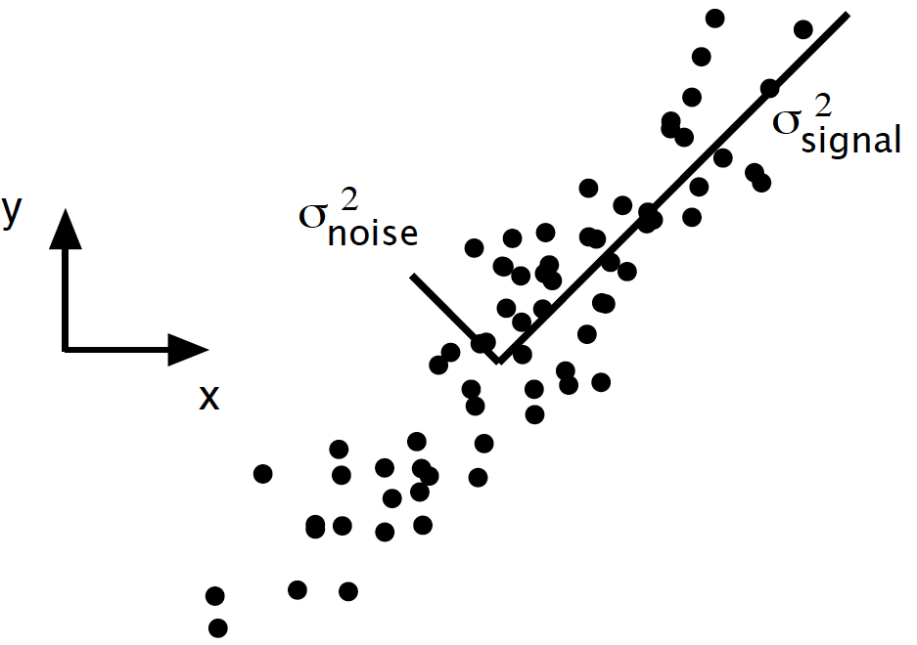
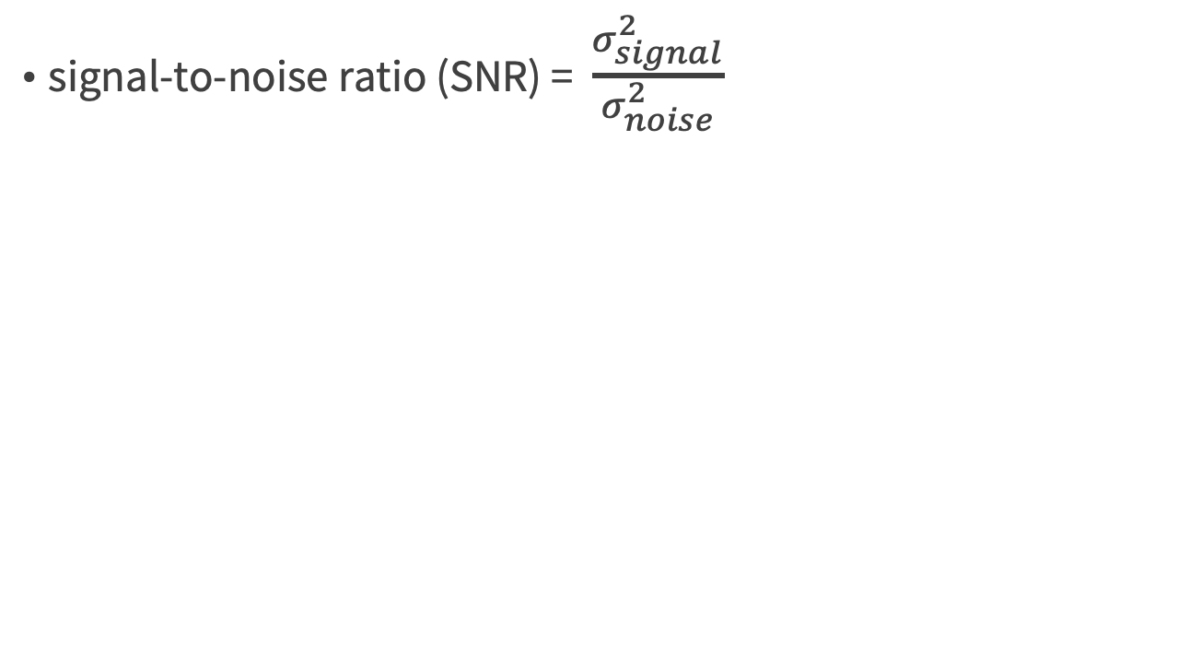
Ratio of variances
signal-to-noise ratio (SNR) = $\frac{σ_{signal}^{2}}{σ_{noise}^{2}}$
Credit: A Tutorial on Principal Component Analysis, Jonathon Shlens

Slide 54
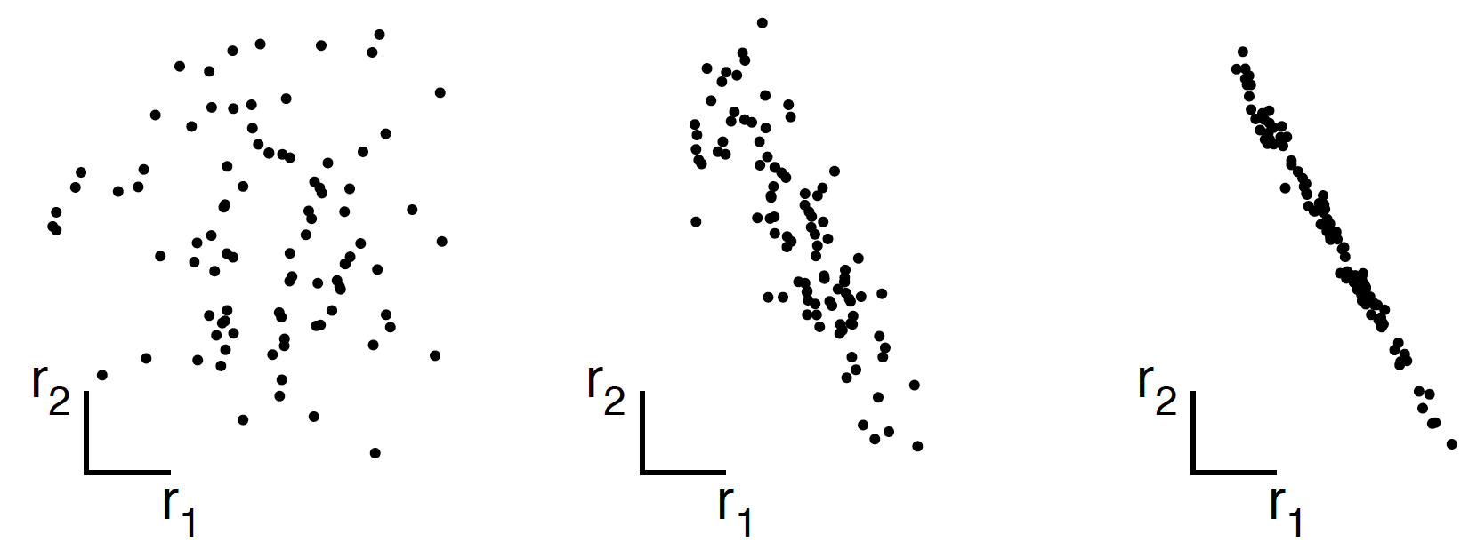
Redundancy
B
B
B
A
A
A
low redundancy
high redundancy
Credit: A Tutorial on Principal Component Analysis, Jonathon Shlens

Slide 55
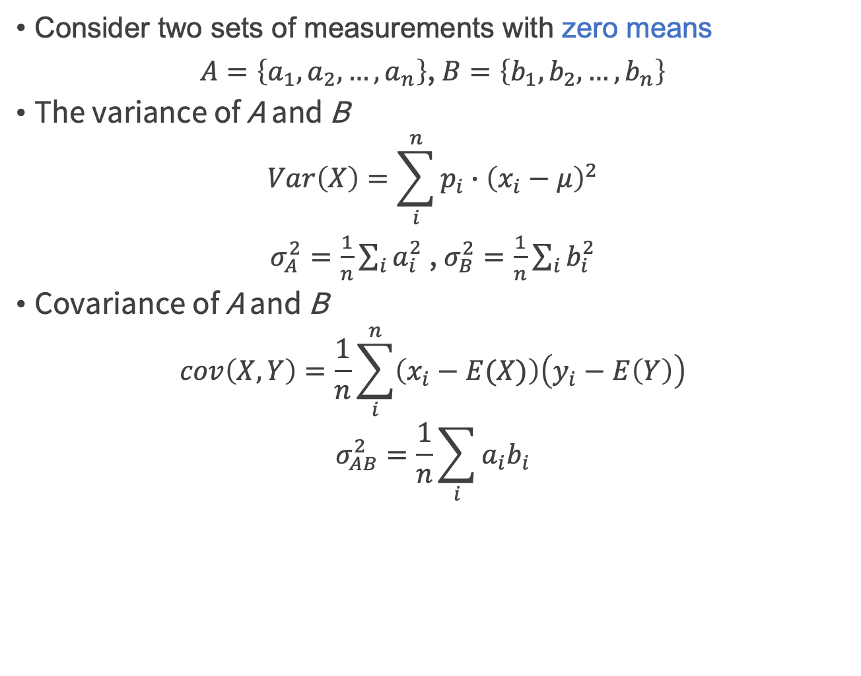
Redundancy measured using Covariance
Consider two sets of measurements with zero means
$A=\left\{a_{1},a_{2},…,a_{n}\right\}$, $B=\left\{b_{1},b_{2},…,b_{n}\right\}$
The variance of A and B
$$Var\left(X\right)=\sum_{i}^{n}{p_{i}∙{\left(x_{i}−μ\right)}^{2}}$$
$σ_{A}^{2}=\frac{1}{n}\sum_{i}{a_{i}^{2}}$ , $σ_{B}^{2}=\frac{1}{n}\sum_{i}{b_{i}^{2}}$
Covariance of A and B
$$cov\left(X,Y\right)=\frac{1}{n}\sum_{i}^{n}{\left(x_{i}−E(X)\right)\left(y_{i}−E\left(Y\right)\right)}$$
$$σ_{AB}^{2}=\frac{1}{n}\sum_{i}{a_{i}b_{i}}$$
Credit: A Tutorial on Principal Component Analysis, Jonathon Shlens

Slide 56
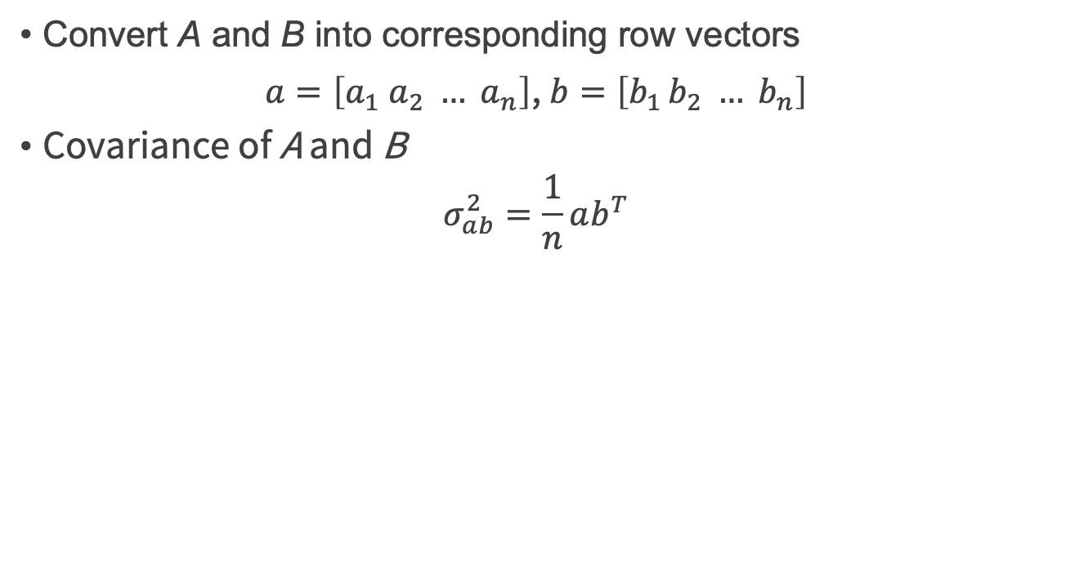
Redundancy measured using Covariance
Convert A and B into corresponding row vectors
$a=\left[a_{1} a_{2} … a_{n}\right]$, $b=\left[b_{1 }b_{2} … b_{n}\right]$
Covariance of A and B
$$σ_{ab}^{2}=\frac{1}{n}ab^{T}$$
Credit: A Tutorial on Principal Component Analysis, Jonathon Shlens

Slide 57
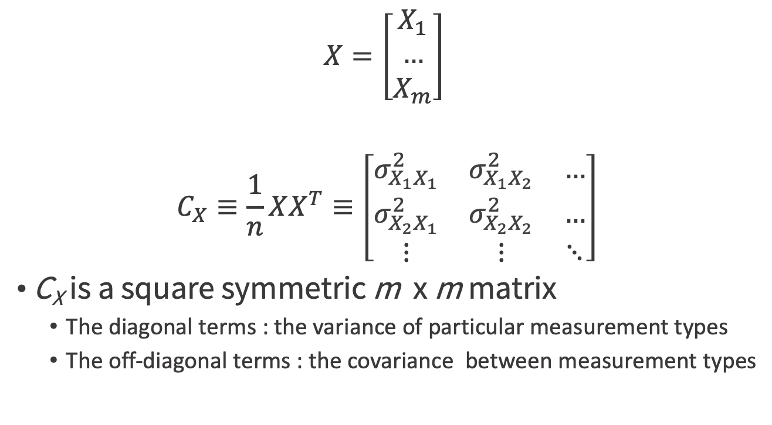
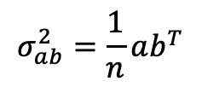
Covariance matrix C_{x}
$$X=\left[\begin{matrix}X_{1} \\ … \\ X_{m}\end{matrix}\right]$$
$$C_{X}≡\frac{1}{n}XX^{T}≡\left[\begin{matrix}σ_{X_{1}X_{1}}^{2} & σ_{X_{1}X_{2}}^{2} & … \\ σ_{X_{2}X_{1}}^{2} & σ_{X_{2}X_{2}}^{2} & … \\ ⋮ & ⋮ & ⋱\end{matrix}\right]$$
C_{X} is a square symmetric m x m matrix
The diagonal terms : the variance of particular measurement types
The off-diagonal terms : the covariance between measurement types
$$σ_{ab}^{2}=\frac{1}{n}ab^{T}$$
Credit: A Tutorial on Principal Component Analysis, Jonathon Shlens

Slide 58
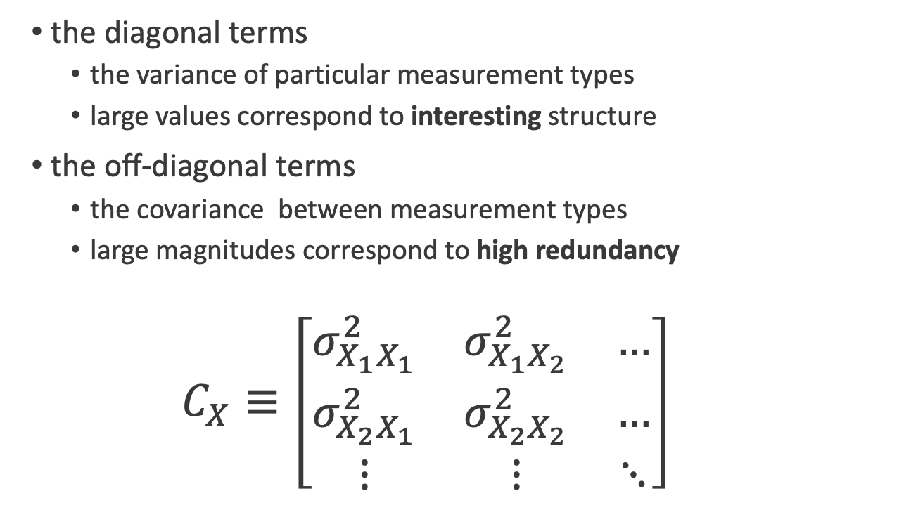
Diagonal vs off-diagonal terms @ C_{X}
the diagonal terms
the variance of particular measurement types
large values correspond to interesting structure
the off-diagonal terms
the covariance between measurement types
large magnitudes correspond to high redundancy
$$C_{X}≡\left[\begin{matrix}σ_{X_{1}X_{1}}^{2} & σ_{X_{1}X_{2}}^{2} & … \\ σ_{X_{2}X_{1}}^{2} & σ_{X_{2}X_{2}}^{2} & … \\ ⋮ & ⋮ & ⋱\end{matrix}\right]$$
Credit: A Tutorial on Principal Component Analysis, Jonathon Shlens

Slide 59
The goal of PCA
Find some orthonormal matrix P in Y = PX
What is the covariance matrix C_{Y} ?
C_{Y} = P C_{X} P^{T} ?
Credit: A Tutorial on Principal Component Analysis, Jonathon Shlens

Slide 60
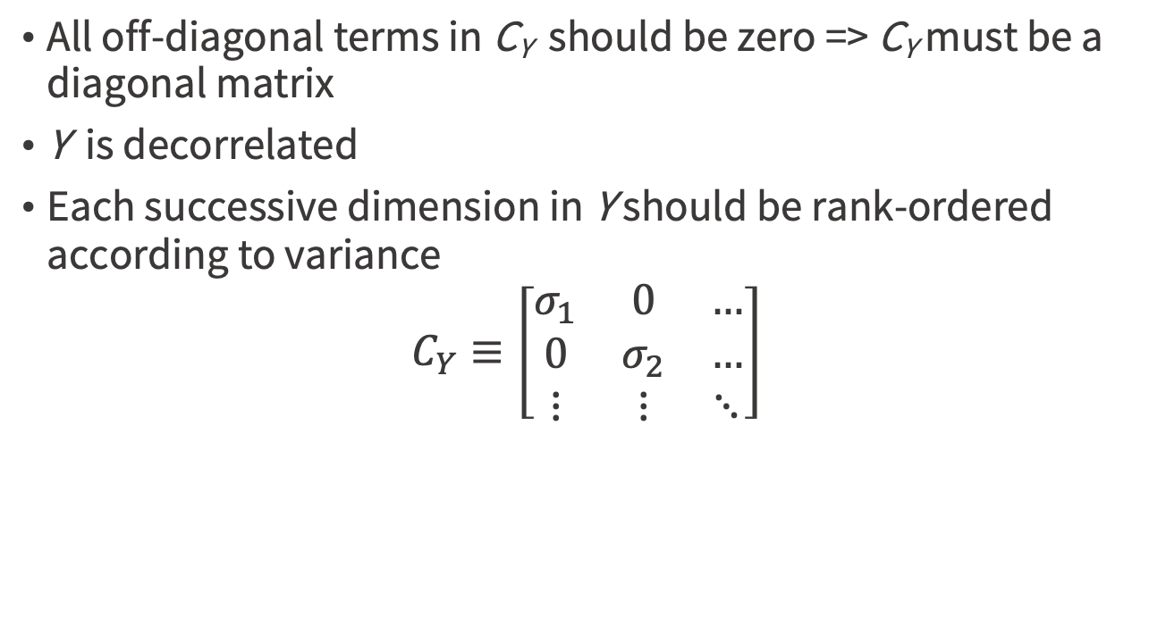
Diagonalize C_{Y}
All off-diagonal terms in C_{Y} should be zero => C_{Y} must be a diagonal matrix
Y is decorrelated
Each successive dimension in Y should be rank-ordered according to variance
$$C_{Y}≡\left[\begin{matrix}σ_{1} & 0 & … \\ 0 & σ_{2} & … \\ ⋮ & ⋮ & ⋱\end{matrix}\right]$$
Credit: A Tutorial on Principal Component Analysis, Jonathon Shlens

Slide 61
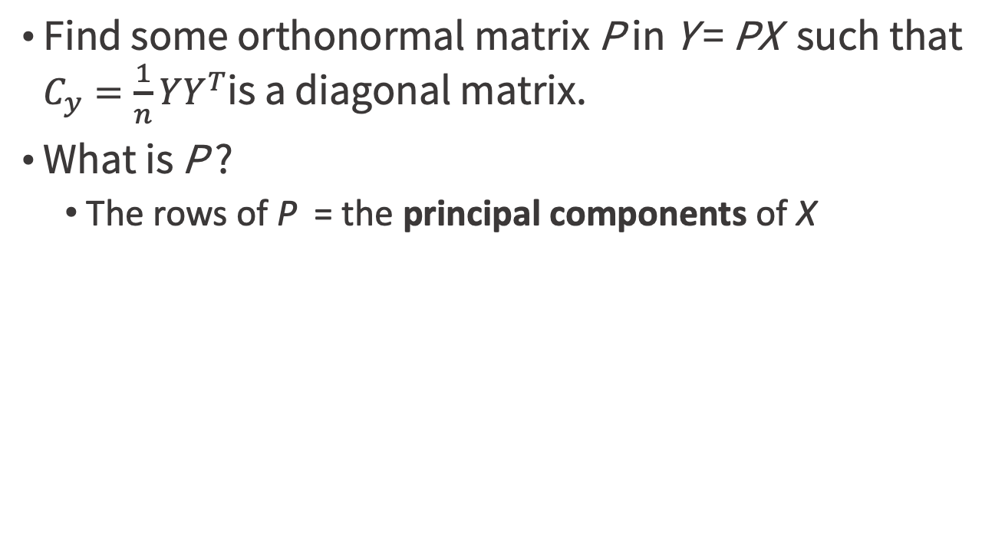
How to diagonalize C_{Y} ?
Find some orthonormal matrix P in Y = PX such that $C_{y}=\frac{1}{n}YY^{T}$is a diagonal matrix.
What is P ?
The rows of P = the principal components of X
Credit: A Tutorial on Principal Component Analysis, Jonathon Shlens

Slide 62
Vector space
linear algebra

Slide 63
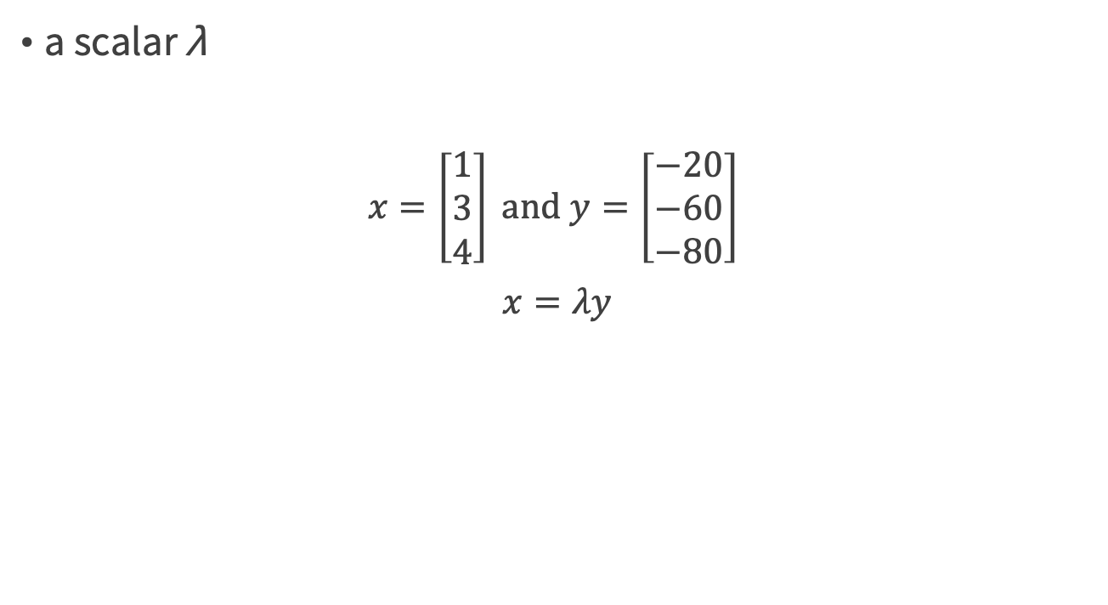
Scalar multiples
a scalar λ
$x=\left[\begin{matrix}1 \\ 3 \\ 4\end{matrix}\right] \text{and} y=\left[\begin{matrix}−20 \\ −60 \\ −80\end{matrix}\right]$
$$x=λy$$
Credit by https://en.wikipedia.org/wiki/Eigenvalues_and_eigenvectors

Slide 64
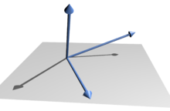
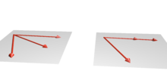
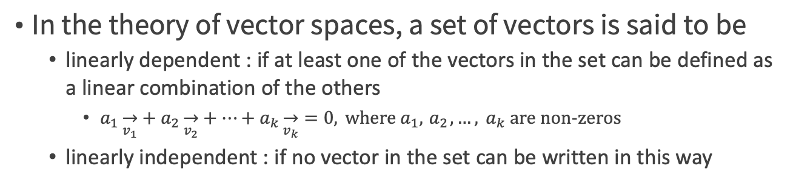
Linearly dependent/independent
In the theory of vector spaces, a set of vectors is said to be
linearly dependent : if at least one of the vectors in the set can be defined as a linear combination of the others
$a_{1}\overset{→}{v_{1}}+a_{2}\overset{→}{v_{2}}+…+a_{k}\overset{→}{v_{k}}=0, \text{where}{ a}_{1},{ a}_{2},…,{ a}_{k} \text{are} \text{non}\text{−}\text{zeros}$
linearly independent : if no vector in the set can be written in this way
Credit by https://en.wikipedia.org/wiki/Linear_independence

Slide 65
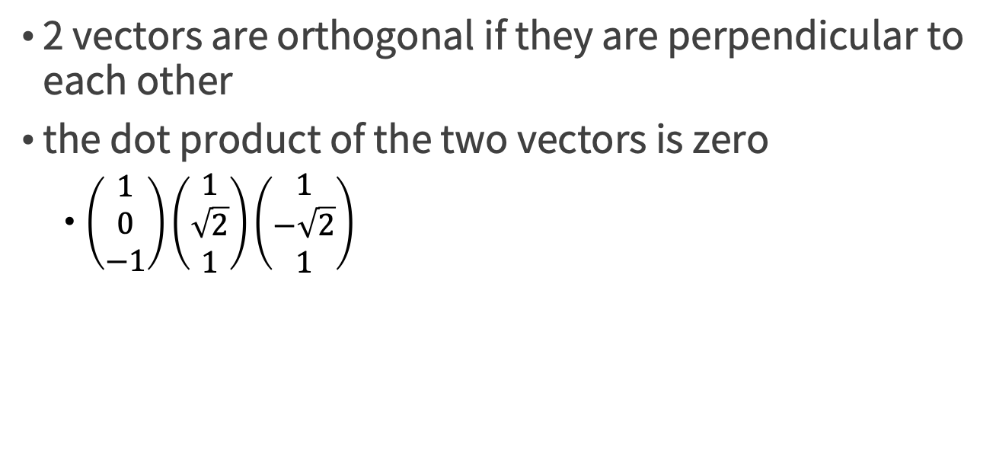
Orthogonal vectors
2 vectors are orthogonal if they are perpendicular to each other
the dot product of the two vectors is zero
$\left(\begin{matrix}1 \\ 0 \\ −1\end{matrix}\right)\left(\begin{matrix}1 \\ \sqrt{2} \\ 1\end{matrix}\right)\left(\begin{matrix}1 \\ −\sqrt{2} \\ 1\end{matrix}\right)$
Credit by https://en.wikipedia.org/wiki/Linear_independence

Slide 66
Principal Component Analysis (PCA)

Slide 67
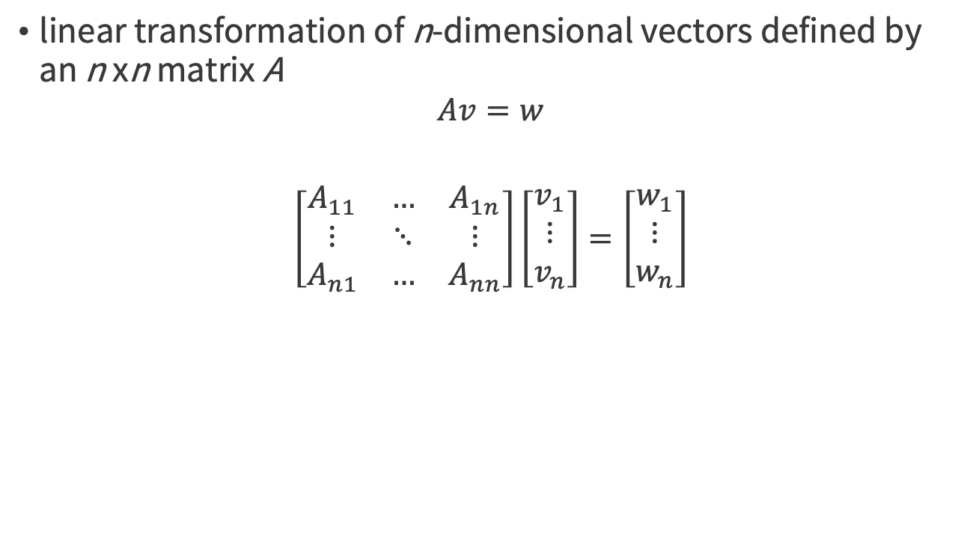
Eigenvalues and eigenvectors
linear transformation of n-dimensional vectors defined by an n xn matrix A
$$Av=w$$
$$\left[\begin{matrix}A_{11} & … & A_{1n} \\ ⋮ & ⋱ & ⋮ \\ A_{n1} & … & A_{nn}\end{matrix}\right]\left[\begin{matrix}v_{1} \\ ⋮ \\ v_{n}\end{matrix}\right]=\left[\begin{matrix}w_{1} \\ ⋮ \\ w_{n}\end{matrix}\right]$$
Credit by https://en.wikipedia.org/wiki/Eigenvalues_and_eigenvectors

Slide 68
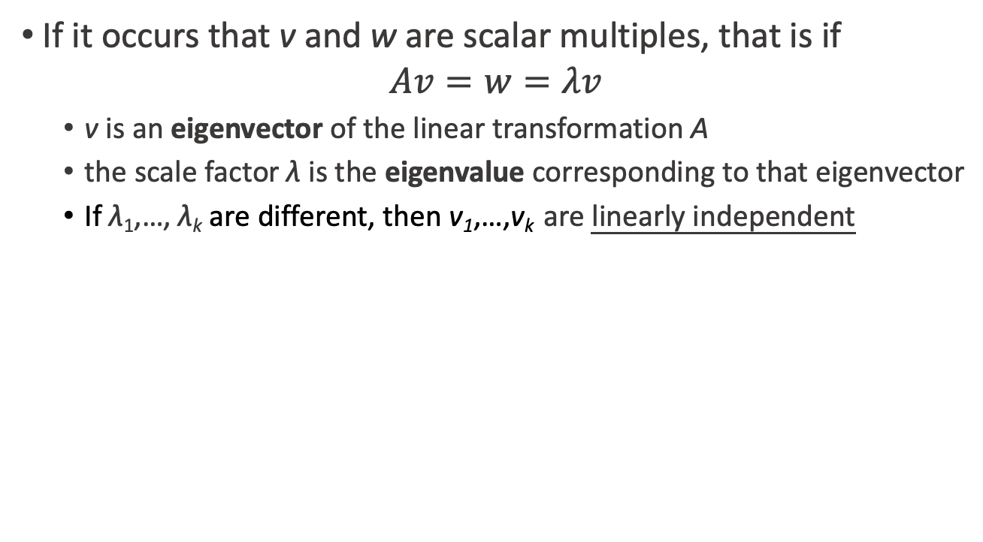
Eigenvalues and eigenvectors
If it occurs that v and w are scalar multiples, that is if $Av=w=λv$
v is an eigenvector of the linear transformation A
the scale factor λ is the eigenvalue corresponding to that eigenvector
If λ₁,…, λ_{k} are different, then v₁,…,v_{k} are linearly independent
Credit by https://en.wikipedia.org/wiki/Eigenvalues_and_eigenvectors

Slide 69
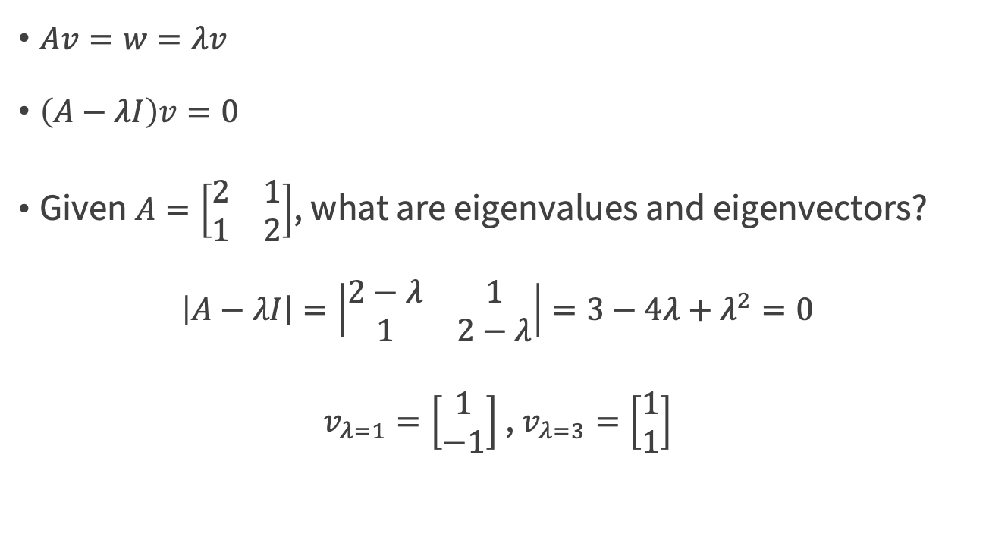
Two-dimensional matrix example
$Av=w=λv$
$\left(A−λI\right)v=0$
Given $A=\left[\begin{matrix}2 & 1 \\ 1 & 2\end{matrix}\right]$, what are eigenvalues and eigenvectors?
$$\left|A−λI\right|=\left|\begin{matrix}2−λ & 1 \\ 1 & 2−λ\end{matrix}\right|=3−4λ+λ^{2}=0$$
$v_{λ=1}=\left[\begin{matrix}1 \\ −1\end{matrix}\right]$ , $v_{λ=3}=\left[\begin{matrix}1 \\ 1\end{matrix}\right]$
Credit by https://en.wikipedia.org/wiki/Eigenvalues_and_eigenvectors

Slide 70
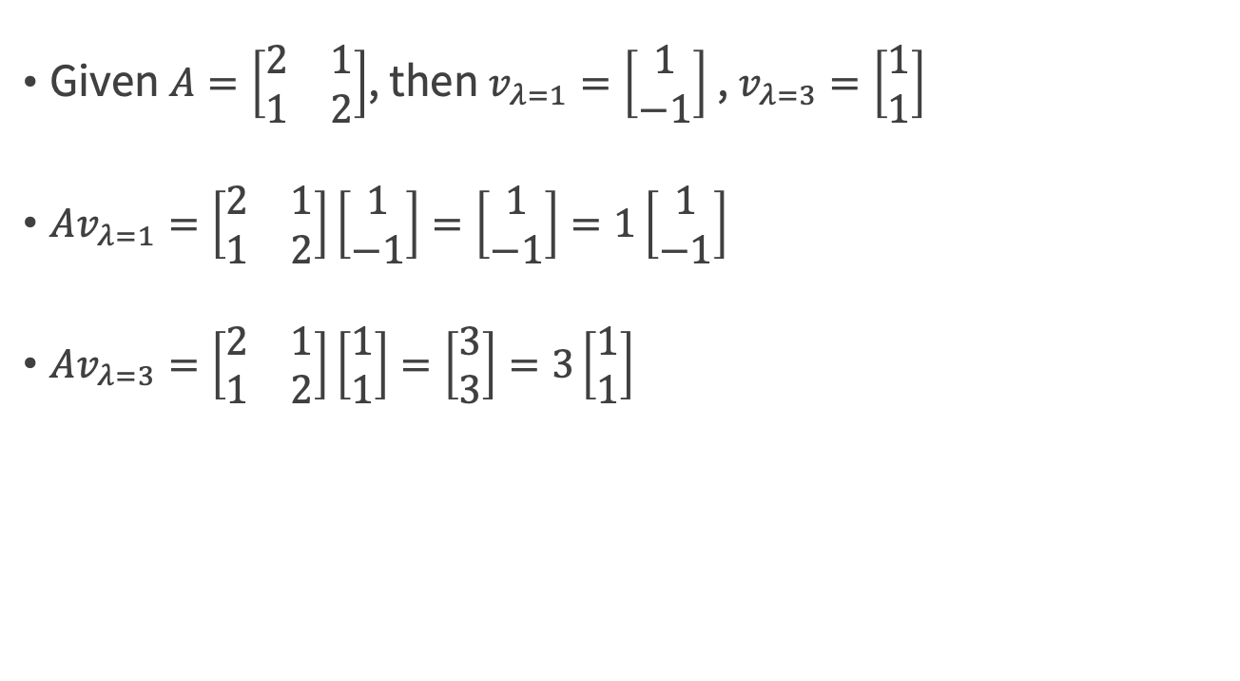
Two-dimensional matrix example
Given $A=\left[\begin{matrix}2 & 1 \\ 1 & 2\end{matrix}\right]$, then $v_{λ=1}=\left[\begin{matrix}1 \\ −1\end{matrix}\right]$ , $v_{λ=3}=\left[\begin{matrix}1 \\ 1\end{matrix}\right]$
$Av_{λ=1}=\left[\begin{matrix}2 & 1 \\ 1 & 2\end{matrix}\right]\left[\begin{matrix}1 \\ −1\end{matrix}\right]=\left[\begin{matrix}1 \\ −1\end{matrix}\right]=1\left[\begin{matrix}1 \\ −1\end{matrix}\right]$
$Av_{λ=3}=\left[\begin{matrix}2 & 1 \\ 1 & 2\end{matrix}\right]\left[\begin{matrix}1 \\ 1\end{matrix}\right]=\left[\begin{matrix}3 \\ 3\end{matrix}\right]=3\left[\begin{matrix}1 \\ 1\end{matrix}\right]$
Credit by https://en.wikipedia.org/wiki/Eigenvalues_and_eigenvectors

Slide 71
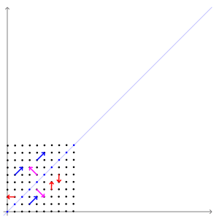

Two-dimensional matrix example
Given $A=\left[\begin{matrix}2 & 1 \\ 1 & 2\end{matrix}\right]$, then $v_{λ=1}=\left[\begin{matrix}1 \\ −1\end{matrix}\right]$ , $v_{λ=3}=\left[\begin{matrix}1 \\ 1\end{matrix}\right]$
Credit by https://en.wikipedia.org/wiki/Eigenvalues_and_eigenvectors

Slide 72
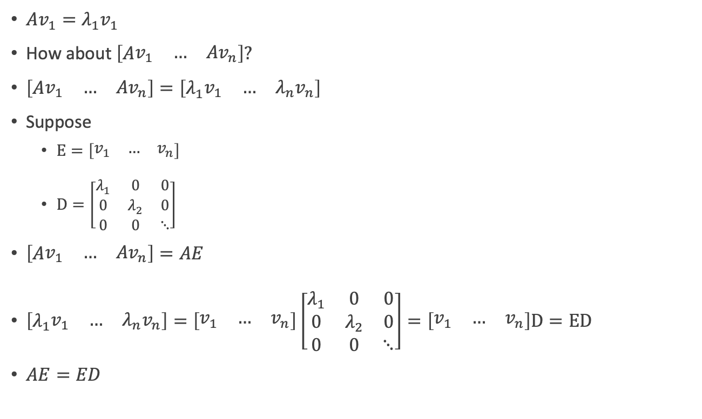

Scalar form $Av_{1}=λ_{1}v_{1}$ to Matrix form $AE=ED$
$Av_{1}=λ_{1}v_{1}$
How about $\left[A\begin{matrix}v_{1} & … & {Av}_{n}\end{matrix}\right]?$
$\left[A\begin{matrix}v_{1} & … & {Av}_{n}\end{matrix}\right]=\left[λ_{1}\begin{matrix}v_{1} & … & {λ_{n}v}_{n}\end{matrix}\right]$
Suppose
$E=\left[\begin{matrix}v_{1} & … & v_{n}\end{matrix}\right]$
$D=\left[\begin{matrix}λ_{1} & 0 & 0 \\ 0 & λ_{2} & 0 \\ 0 & 0 & ⋱\end{matrix}\right]$
$\left[A\begin{matrix}v_{1} & … & {Av}_{n}\end{matrix}\right]=AE$
$\left[λ_{1}\begin{matrix}v_{1} & … & {λ_{n}v}_{n}\end{matrix}\right]=\left[\begin{matrix}v_{1} & … & v_{n}\end{matrix}\right]\left[\begin{matrix}λ_{1} & 0 & 0 \\ 0 & λ_{2} & 0 \\ 0 & 0 & ⋱\end{matrix}\right]=\left[\begin{matrix}v_{1} & … & v_{n}\end{matrix}\right]D=ED$
$AE=ED$
Credit: A Tutorial on Principal Component Analysis, Jonathon Shlens

Slide 73
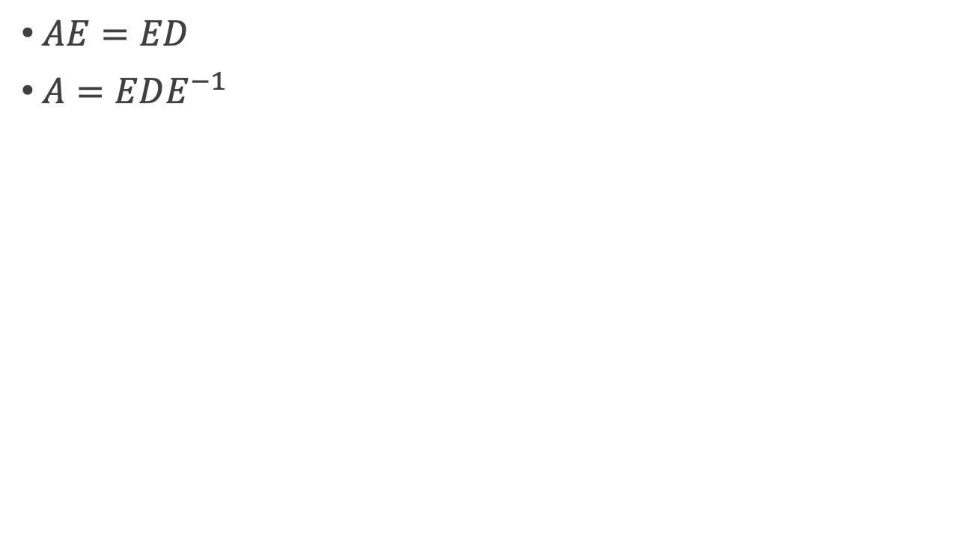
Eigenvector Decomposition
$AE=ED$
$A=EDE^{−1}$
Credit: A Tutorial on Principal Component Analysis, Jonathon Shlens

Slide 74

$$\text{Eigenvector} \text{Decomposition}$$
For a symmetric matrix A, A=EDE^{T} , where
D is a diagonal matrix
E is a matrix of eigenvectors of A arranged as columns
Based on
Theorem1: a matrix is symmetric if and only if it is orthogonally diagonalizable
Theorem2: a symmetric matrix is diagonalized by a matrix of its orthogonal eigenvectors
Credit: A Tutorial on Principal Component Analysis, Jonathon Shlens

Slide 75
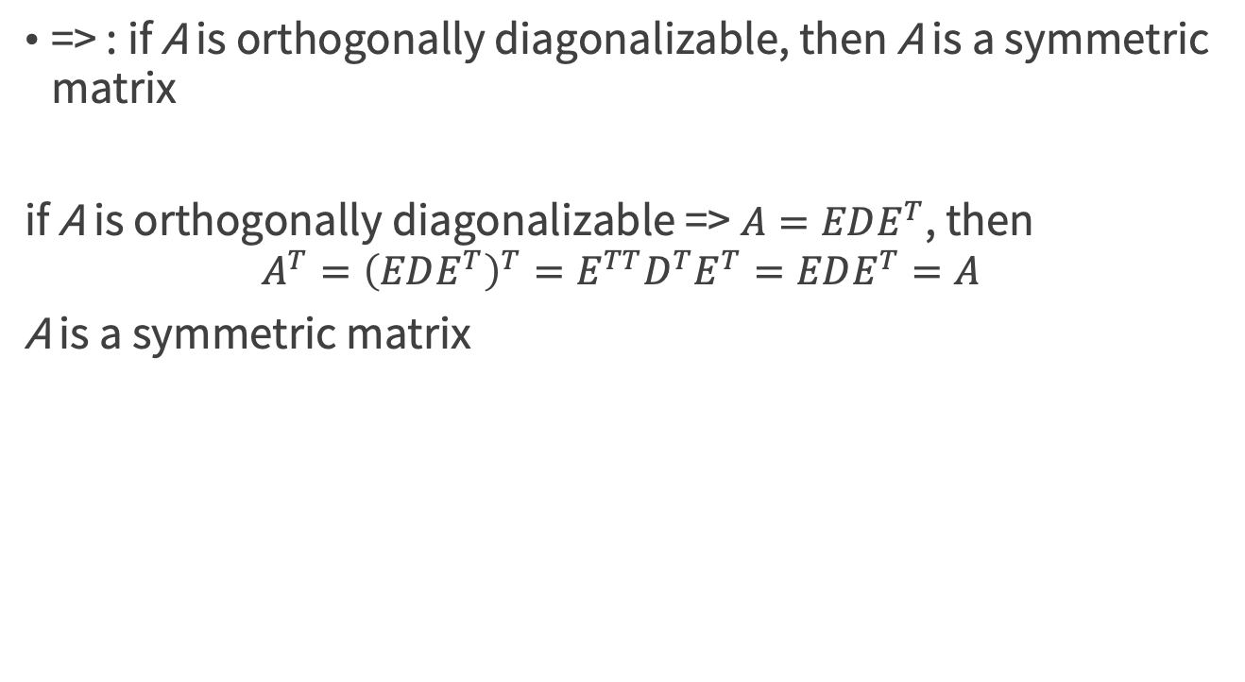
Theorem1: a matrix is symmetric if and only if it is orthogonally diagonalizable
=> : if A is orthogonally diagonalizable, then A is a symmetric matrix
if A is orthogonally diagonalizable => $A=EDE^{T}$, then
$$A^{T}={\left(EDE^{T}\right)}^{T}=E^{TT}D^{T}E^{T}=EDE^{T}=A$$
A is a symmetric matrix
Credit: A Tutorial on Principal Component Analysis, Jonathon Shlens

Slide 76
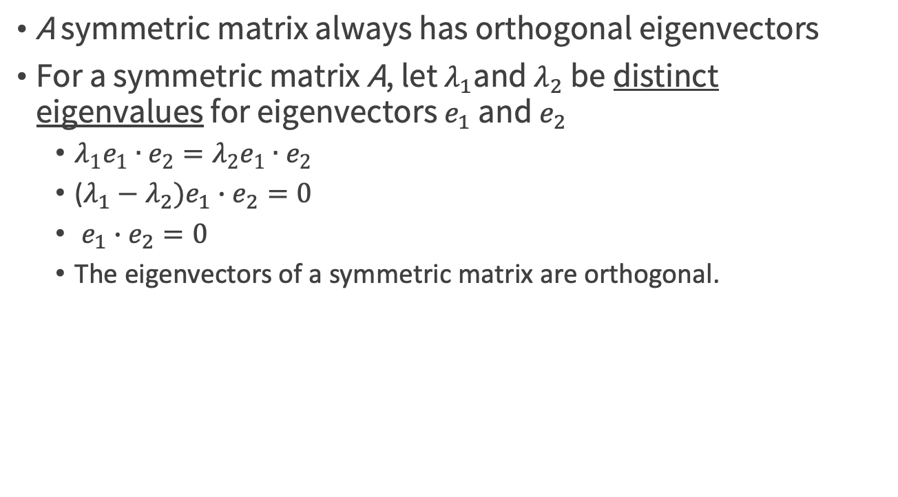
Theorem2: a symmetric matrix is diagonalized by a matrix of its orthogonal eigenvectors
A symmetric matrix always has orthogonal eigenvectors
For a symmetric matrix A, let $λ_{1}$and $λ_{2}$ be distinct eigenvalues for eigenvectors $e_{1}$ and $e_{2}$
$λ_{1}e_{1}∙e_{2}=λ_{2}e_{1}∙e_{2}$
($λ_{1}−λ_{2})e_{1}∙e_{2}=0$
$e_{1}∙e_{2}=0$
The eigenvectors of a symmetric matrix are orthogonal.

Slide 77
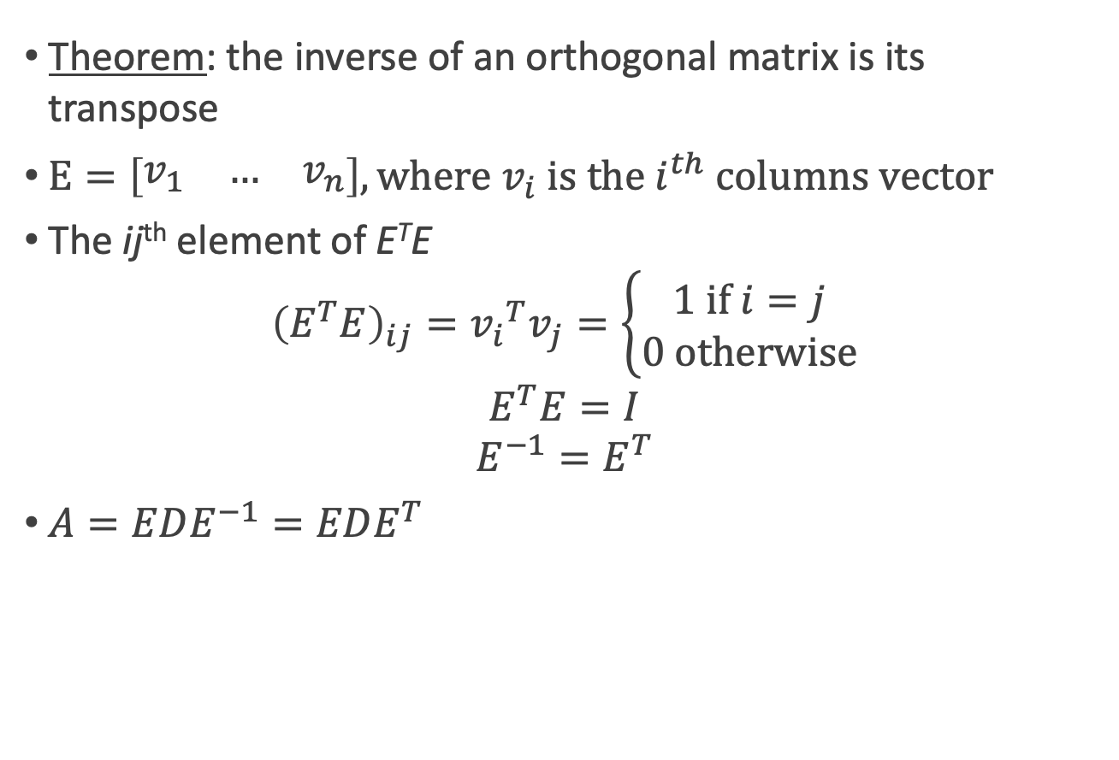
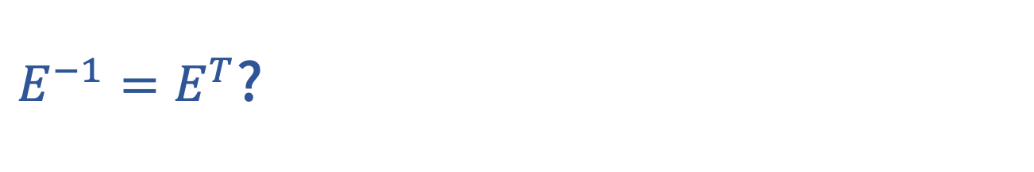
$E^{−1}=E^{T}$?
Theorem: the inverse of an orthogonal matrix is its transpose
$E=\left[\begin{matrix}v_{1} & … & v_{n}\end{matrix}\right], where v_{i} \text{is} \text{the} i^{th} \text{columns} \text{vector}$
The ij^{th} element of E^{T}E
$${\left(E^{T}E\right)}_{ij}={v_{i}}^{T}v_{j}=\left\{\begin{aligned}1 \text{if} i=j \\ 0 \text{otherwise}\end{aligned}\right.$$
$$E^{T}E=I$$
$$E^{−1}=E^{T}$$
$A=EDE^{−1}=EDE^{T}$
Credit: A Tutorial on Principal Component Analysis, Jonathon Shlens

Slide 78
Solving PCA by Eigenvector Decomposition
For a symmetric matrix A, A=EDE^{T} , where
D is a diagonal matrix
E is a matrix of eigenvectors of A arranged as columns.
C_{x} = EDE^{T}
We select the matrix P to be a matrix where each row p_{i} is an eigenvector of C_{X}
Let Y =PX, then C_{Y} = D ?
Credit: A Tutorial on Principal Component Analysis, Jonathon Shlens

Slide 79
Another Interpretation of Principal Components
The first principal component loading vector has a very special property
it is the line in p-dimensional space that is closest to the n observations (using average squared Euclidean distance as a measure of closeness)
the first M principal component score vectors and the first M principal component loading vectors provide the best M-dimensional approximation (in terms of Euclidean distance)
An Introduction to Statistical Learning with Applications in R by Gareth James, Daniela Witten, Trevor Hastie, Robert Tibshirani

Slide 80
Summary of PCA
The principal components of X are the eigenvectors of C_{X}
The i ^{th} diagonal value of C_{Y} is the variance of X along p_{i}
In practice
Subtracting off the mean of each measurement type
Computing the eigenvectors of C_{x}
Credit: A Tutorial on Principal Component Analysis, Jonathon Shlens

Slide 81
Single Value Decomposition (SVD)

Slide 82
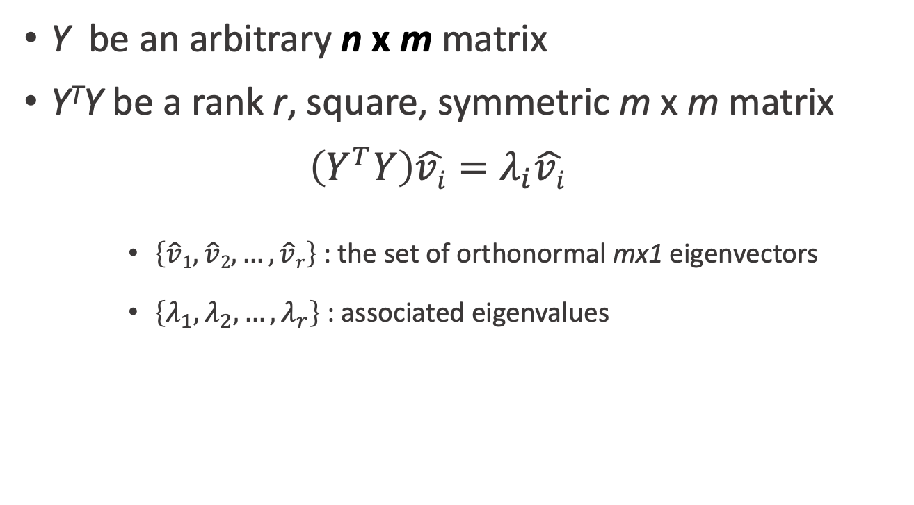
A more general solution using SVD
Y be an arbitrary n x m matrix
Y^{T}Y be a rank r, square, symmetric m x m matrix
$$\left(Y^{T}Y\right)\hat{vi}=λ_{i}\hat{vi}$$
$\left\{\hat{v}1,\hat{v}2,…,\hat{v}r\right\}$ : the set of orthonormal mx1 eigenvectors
$\left\{λ_{1},λ_{2},…,λ_{r}\right\}$: associated eigenvalues
Credit: A Tutorial on Principal Component Analysis, Jonathon Shlens

Slide 83
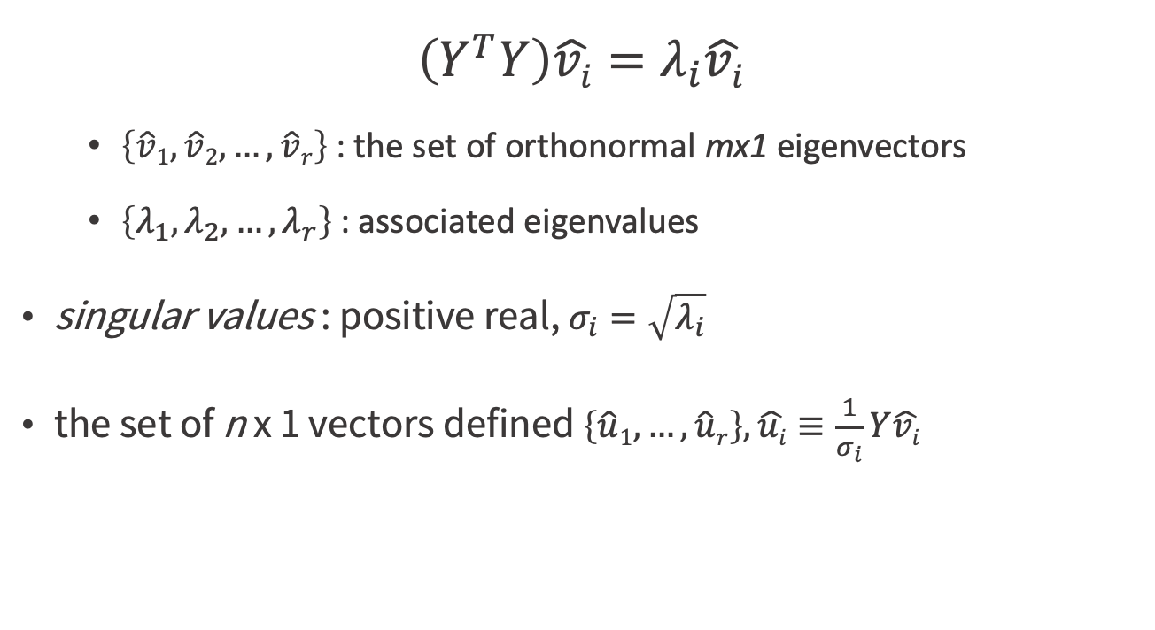
A more general solution using SVD
$$\left(Y^{T}Y\right)\hat{vi}=λ_{i}\hat{vi}$$
$\left\{\hat{v}1,\hat{v}2,…,\hat{v}r\right\}$ : the set of orthonormal mx1 eigenvectors
$\left\{λ_{1},λ_{2},…,λ_{r}\right\}$: associated eigenvalues
singular values : positive real, $σ_{i}=\sqrt{λ_{i}}$
the set of n x 1 vectors defined $\left\{\hat{u}1, …,\hat{u}r\right\}, \hat{ui}≡\frac{1}{σ_{i}}Y\hat{vi}$
Credit: A Tutorial on Principal Component Analysis, Jonathon Shlens

Slide 84
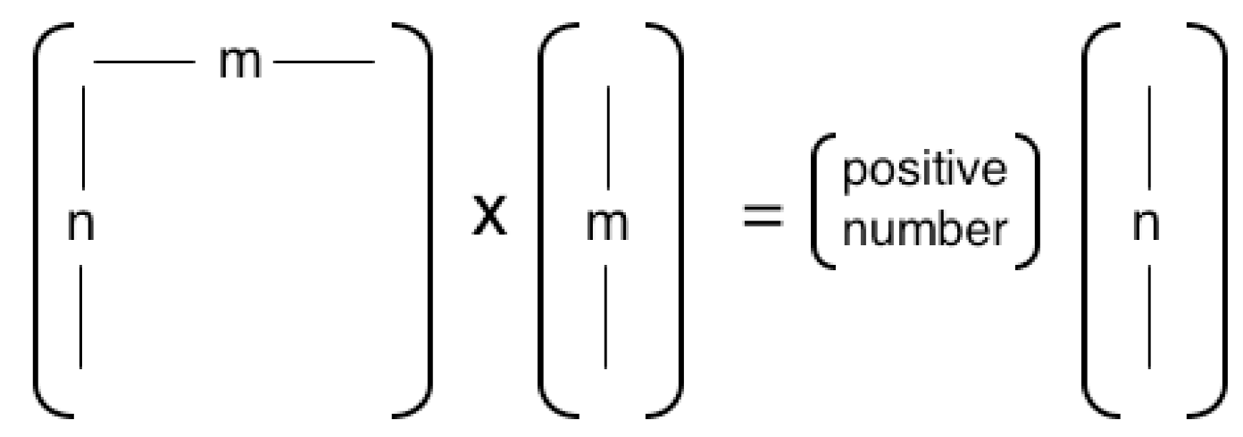
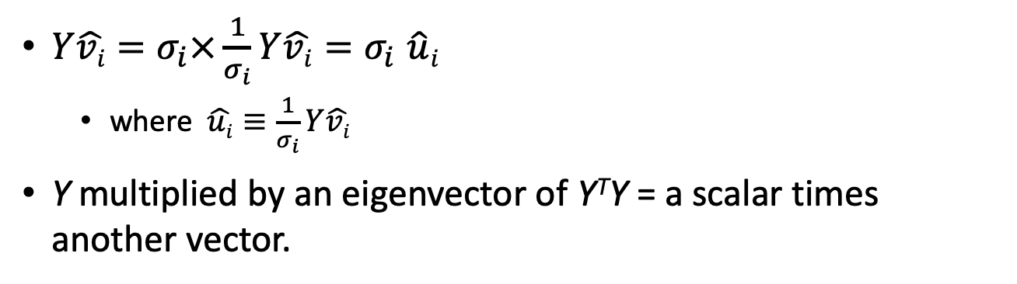
The scalar form of SVD
$Y\hat{vi}=σ_{i}×\frac{1}{σ_{i}}Y\hat{vi}{=σ}_{i}\hat{u}i$
where $\hat{ui}≡\frac{1}{σ_{i}}Y\hat{vi}$
Y multiplied by an eigenvector of Y^{T}Y = a scalar times another vector.
Credit: A Tutorial on Principal Component Analysis, Jonathon Shlens

Slide 85

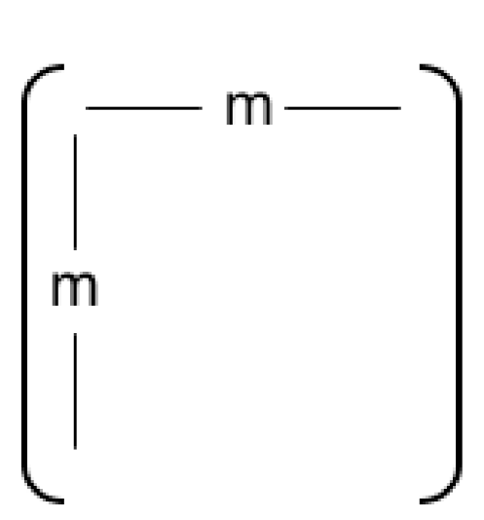
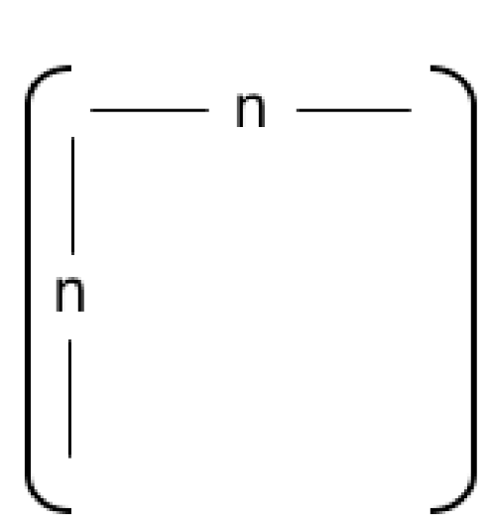
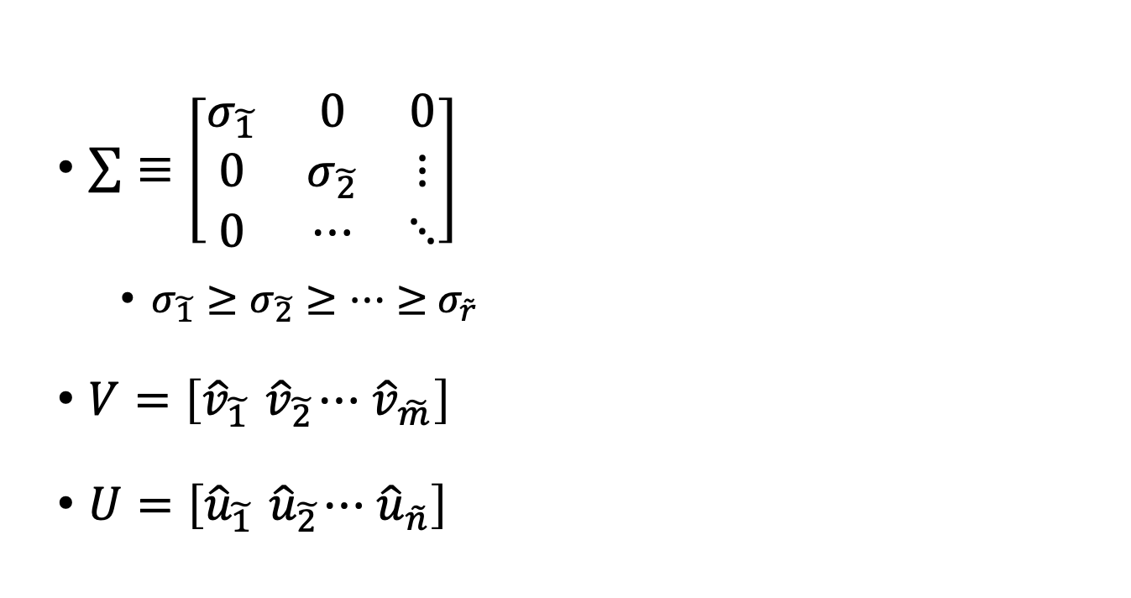
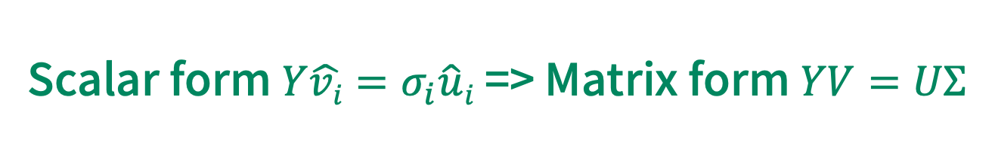
Scalar form $Y\hat{vi}=σ_{i}\hat{u}i$ => Matrix form $YV=UΣ$
$\sum{≡\left[\begin{matrix}σ_{\tilde{1}} & 0 & 0 \\ 0 & σ_{\tilde{2}} & ⋮ \\ 0 & ⋯ & ⋱\end{matrix}\right]}$
$σ_{\tilde{1}}≥σ_{\tilde{2}}≥⋯≥$ $σ_{\tilde{r}}$
$V=\left[{\hat{v}}_{\tilde{1}}{ \hat{v}}_{\tilde{2}}⋯{ \hat{v}}_{\tilde{m}}\right]$
$U=\left[{\hat{u}}_{\tilde{1}}{ \hat{u}}_{\tilde{2}}⋯{ \hat{u}}_{\tilde{n}}\right]$
Credit: A Tutorial on Principal Component Analysis, Jonathon Shlens

Slide 86
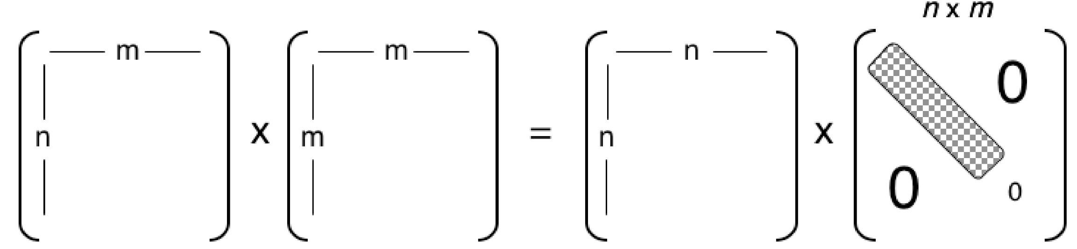

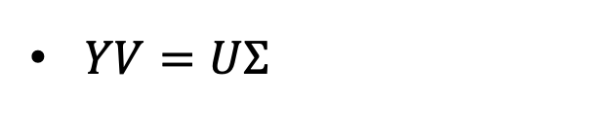
Construction of the matrix form of SVD from the scalar form
$Y\hat{vi}=σ_{i}\hat{u}i$
$YV=UΣ$
Credit: A Tutorial on Principal Component Analysis, Jonathon Shlens

Slide 87
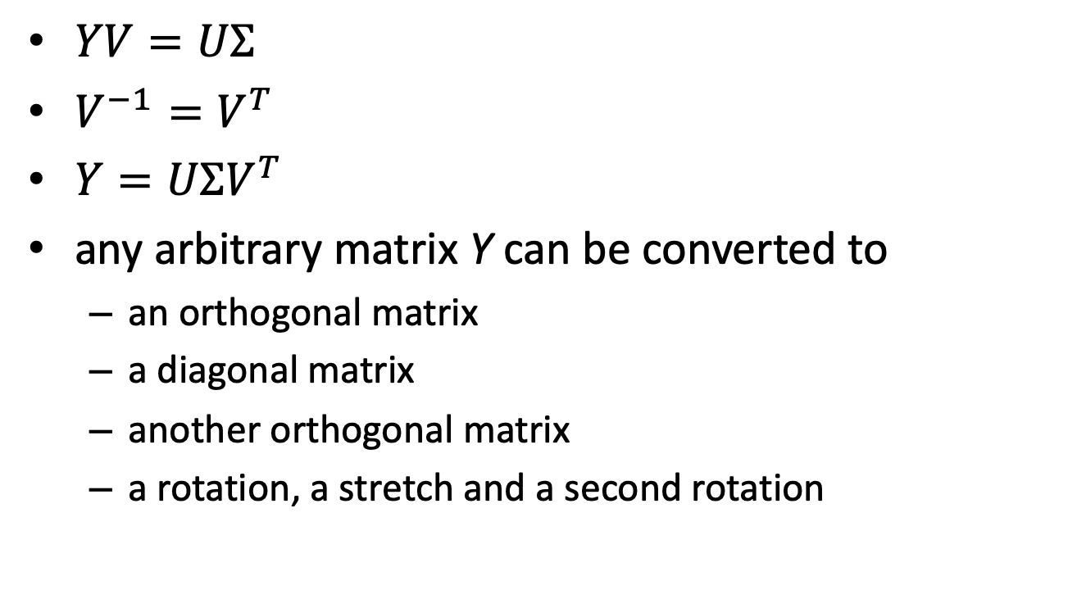
Single Value Decomposition (SVD)
$YV=UΣ$
$V^{−1}=V^{T}$
$Y=UΣV^{T}$
any arbitrary matrix Y can be converted to
an orthogonal matrix
a diagonal matrix
another orthogonal matrix
a rotation, a stretch and a second rotation
Credit: A Tutorial on Principal Component Analysis, Jonathon Shlens

Slide 88
Visualization of the matrix multiplications in SVD
Y
n
m
n
n
m
m
m
n
Credit by CMG Lee @ https://en.wikipedia.org/wiki/Singular_value_decomposition

Slide 89
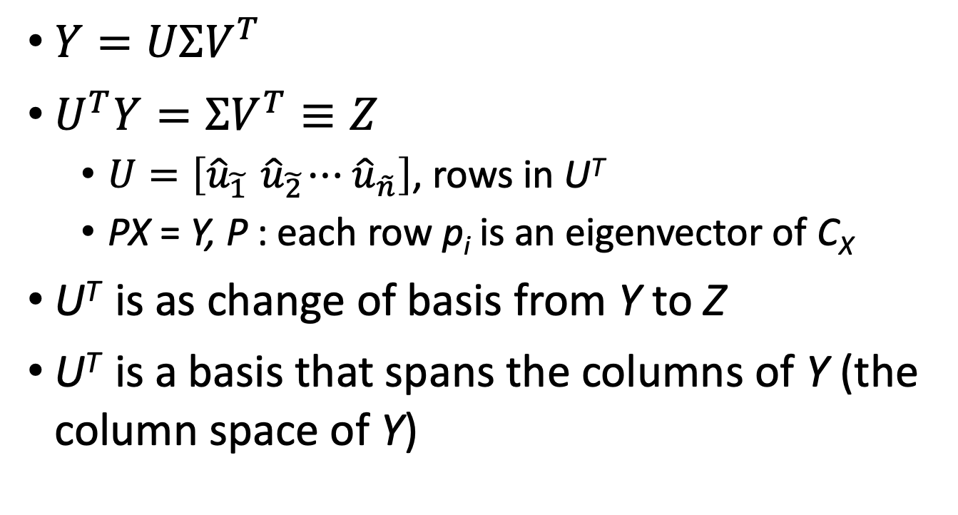
Interpreting SVD : column space
$Y=UΣV^{T}$
$U^{T}Y=ΣV^{T}≡Z$
$U=\left[{\hat{u}}_{\tilde{1}}{ \hat{u}}_{\tilde{2}}⋯{ \hat{u}}_{\tilde{n}}\right]$, rows in U^{T}
PX = Y, P : each row p_{i} is an eigenvector of C_{X}
U^{T} is as change of basis from Y to Z
U^{T} is a basis that spans the columns of Y (the column space of Y)
Credit: A Tutorial on Principal Component Analysis, Jonathon Shlens

Slide 90
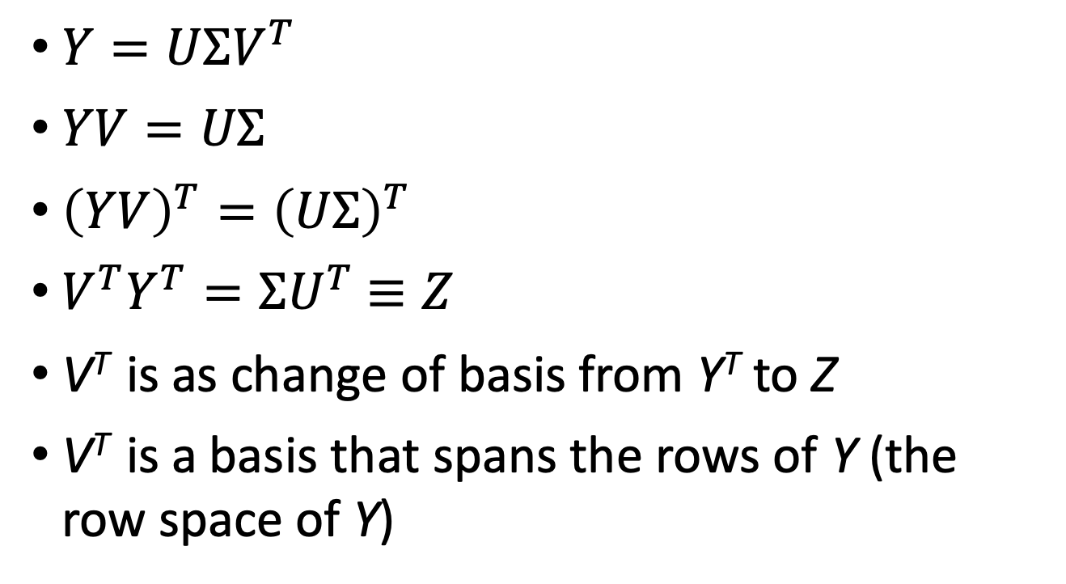
Interpreting SVD : row space
$Y=UΣV^{T}$
$YV=UΣ$
${\left(YV\right)}^{T}={\left(UΣ\right)}^{T}$
${V^{T}Y}^{T}={ΣU}^{T}$ $≡Z$
V^{T} is as change of basis from Y^{T} to Z
V^{T} is a basis that spans the rows of Y (the row space of Y)
Credit: A Tutorial on Principal Component Analysis, Jonathon Shlens

Slide 91
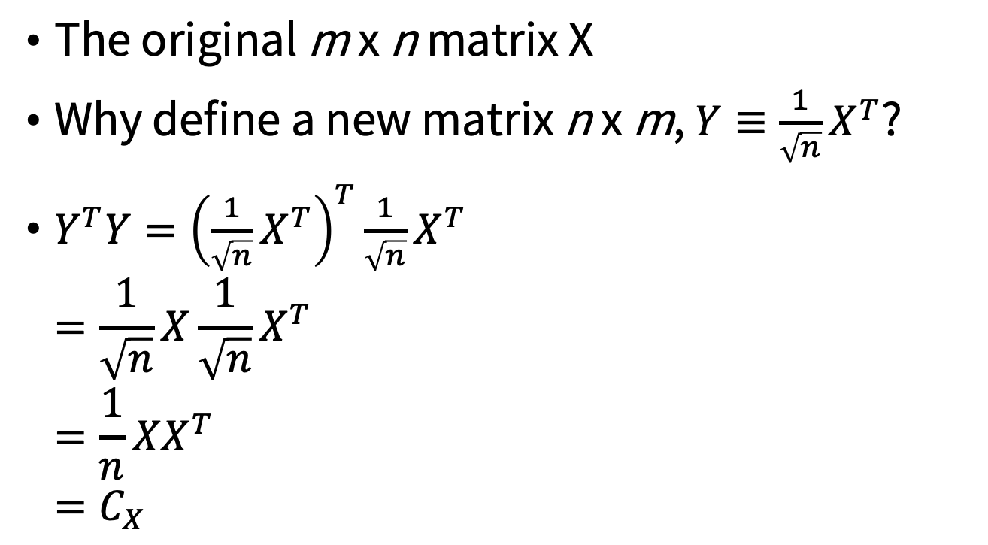
Why Y be an arbitrary n x m matrix?
The original m x n matrix X
Why define a new matrix n x m, $Y≡\frac{1}{\sqrt{n}}X^{T}$?
$Y^{T}Y={\left(\frac{1}{\sqrt{n}}X^{T}\right)}^{T}\frac{1}{\sqrt{n}}X^{T}$ $=\frac{1}{\sqrt{n}}X\frac{1}{\sqrt{n}}X^{T}$ $=\frac{1}{n}XX^{T}$ $=C_{X}$

Slide 92


SVD and PCA
SVD
$Y=UΣV^{T}$
The columns of matrix V contain the eigenvectors of Y^{T}Y
PCA
The principal components of X = the eigenvectors of C_{X}
Y^{T}Y =C_{X}
The columns of matrix V are the principal components of X

Slide 93

SVD and PCA
V spans the row space of $Y≡\frac{1}{\sqrt{n}}X^{T}$
V spans the column space of $\frac{1}{\sqrt{n}}X$
Find the principal components = find an orthonormal basis that spans the column space of X
Credit: A Tutorial on Principal Component Analysis, Jonathon Shlens

Slide 94


Singular Value Decomposition
$Y=UΣV^{T}$
Reduced feature size = 40 features
m
(n
40
m )
n
Term-document matrix
Notes:
SVD
reduces the # of features from 18,081 → 40

Slide 95

Quick Summary of PCA
Organize data as an m x n matrix, X
m : the number of measurement types
n : the number of samples
Subtract off the mean for each measurement type
Calculate the SVD on $\frac{1}{\sqrt{n}}X^{T}$
the eigenvectors of the covariance C_{X}
Credit: A Tutorial on Principal Component Analysis, Jonathon Shlens

Slide 96
Assumptions behind PCA
Linearity
Large variances have important structure
The principal components are orthogonal
Credit: A Tutorial on Principal Component Analysis, Jonathon Shlens

Slide 97
PCA practice

Slide 98
pca.R
# Load data
data(iris)
head(iris, 3)
# log transform
log.ir <- log(iris[, 1:4])
ir.species <- iris[, 5]
# apply PCA - scale. = TRUE is highly advisable, but default is FALSE.
ir.pca <- prcomp(log.ir,center = TRUE, scale. = TRUE)
Credit by thiagogm, https://www.r-bloggers.com/computing-and-visualizing-pca-in-r/

Slide 99
prcomp function
Performs a principal components analysis on the given data matrix
The calculation is done by a singular value decomposition of the (centered and possibly scaled) data matrix, not by using eigen on the covariance matrix.
Center: a logical value indicating whether the variables should be shifted to be zero centered, i.e. the mean of a variable is subtracted from each observation of that variable.
Scale: a logical value indicating whether the variables should be scaled to have unit variance before the analysis takes place (i.e. a variance of 1, and hence a standard deviation of 1).
Credit by thiagogm, https://www.r-bloggers.com/computing-and-visualizing-pca-in-r/

Slide 100

Scaling the Variables
The variance of Murder, Rape, Assault, UrbanPop = 18. 97, 87. 73, 6945. 16, and 209. 5, respectively.
Figure 10.3, An Introduction to Statistical Learning with Applications in R by Gareth James, Daniela Witten, Trevor Hastie, Robert Tibshirani

Slide 101
The class of prcomp
print(ir.pca)
Sdev: the standard deviations of the principal components (i.e., the square roots of the eigenvalues of the covariance/correlation matrix).
Rotation: the matrix of variable loadings (i.e., a matrix whose columns contain the eigenvectors).
Rotation:
PC1 PC2 PC3 PC4
Sepal.Length 0.5038236 -0.45499872 0.7088547 0.19147575
Sepal.Width -0.3023682 -0.88914419 -0.3311628 -0.09125405
Petal.Length 0.5767881 -0.03378802 -0.2192793 -0.78618732
Petal.Width 0.5674952 -0.03545628 -0.5829003 0.58044745
Credit by thiagogm, https://www.r-bloggers.com/computing-and-visualizing-pca-in-r/

Slide 102
PCA : Analyzing the results
# summary method
summary(ir.pca)
# plot method
plot(ir.pca, type = "l")
Credit by thiagogm, https://www.r-bloggers.com/computing-and-visualizing-pca-in-r/

Slide 103


proportion of variance explained (PVE)
$\text{PVE}=\frac{\sum_{i=1}^{n}{{\left(\sum_{j=1}^{p}{φ_{jm}x_{ij}}\right)}^{2}}}{\sum_{j=1}^{p}{\sum_{i=1}^{n}{x_{ij}^{2}}}}$
elbow
Figure 10.4, An Introduction to Statistical Learning with Applications in R by Gareth James, Daniela Witten, Trevor Hastie, Robert Tibshirani

Slide 104
Biplot for Principal Components using ggplot2
library(ggbiplot)
g <- ggbiplot(ir.pca, obs.scale = 1, var.scale = 1, groups = ir.species)
g <- g + scale_color_discrete(name = '')
g <- g + theme(legend.direction = 'horizontal', legend.position = 'top')
print(g)
Credit by thiagogm, https://www.r-bloggers.com/computing-and-visualizing-pca-in-r/

Slide 105
PCA : visualization
Rotation:
PC1 PC2 PC3 PC4
Sepal.Length 0.5038236 -0.45499872 0.7088547 0.19147575
Sepal.Width -0.3023682 -0.88914419 -0.3311628 -0.09125405
Petal.Length 0.5767881 -0.03378802 -0.2192793 -0.78618732
Petal.Width 0.5674952 -0.03545628 -0.5829003 0.58044745
Credit by thiagogm, https://www.r-bloggers.com/computing-and-visualizing-pca-in-r/

Slide 106
PCA : visualization
g <- ggbiplot(ir.pca, obs.scale = 1, var.scale = 1, groups = ir.species, ellipse = TRUE, circle = TRUE)
g <- g + scale_color_discrete(name = '')
g <- g + theme(legend.direction = 'horizontal',legend.position = 'top')
print(g)
#ellipse: draw a normal data ellipse for each groupellipse.prob = 0.68, why?
Credit by thiagogm, https://www.r-bloggers.com/computing-and-visualizing-pca-in-r/

Slide 107
PCA : visualization
g <- ggbiplot(ir.pca, obs.scale = 1, var.scale = 1,
groups = ir.species, ellipse = TRUE,
circle = TRUE)
g <- g + scale_color_discrete(name = '')
g <- g + theme(legend.direction = 'horizontal',
legend.position = 'top')
print(g)
circle: draw a correlation circle (only applies when prcomp was called with scale = TRUE and when var.scale = 1)
sum(ir.pca$rotation[1,]*ir.pca$rotation[1,])
Credit by thiagogm, https://www.r-bloggers.com/computing-and-visualizing-pca-in-r/

Slide 108
PCA for prediction
# Predict PCs
predict(ir.pca, newdata=tail(log.ir, 2))
Credit by thiagogm, https://www.r-bloggers.com/computing-and-visualizing-pca-in-r/

Slide 109
USArrests
For each of the 50 states in the United States, the data set contains the number of arrests per 100,000 residents for each of three crimes: Assault , Murder, and Rape. We also record UrbanPop (the percent of the population in each state livingin urban areas).
n = 50, p = 4
An Introduction to Statistical Learning with Applications in R by Gareth James, Daniela Witten, Trevor Hastie, Robert Tibshirani

Slide 110


biplot display
principal component scores + principal component loadings
Figure10.1, An Introduction to Statistical Learning with Applications in R by Gareth James, Daniela Witten, Trevor Hastie, Robert Tibshirani

Slide 111


Figure6.14 & 6.15, An Introduction to Statistical Learning with Applications in R by Gareth James, Daniela Witten, Trevor Hastie, Robert Tibshirani

Slide 112

Figure 10.2, An Introduction to Statistical Learning with Applications in R by Gareth James, Daniela Witten, Trevor Hastie, Robert Tibshirani

Slide 113
Correspondence Analysis (CA)

Slide 114


How writers punctuate?
Aloz = [2699 5675 1046]
Credit : HervLe Abdi & Lynne J. Williams, Correspondence Analysis

Slide 115



The matrix of deviations
row profile, R =
Barycenter, C^{T} = [.2973 .5642 .1385]
matrix of deviations, $Y=R−\left(1_{I×1}×C^{T}\right)$
Credit : HervLe Abdi & Lynne J. Williams, Correspondence Analysis

Slide 116

Masses (rows)
the mass of each row is the proportion of this row in the total of the table.
=> The mass of each row reflects its importance in the sample
Credit : HervLe Abdi & Lynne J. Williams, Correspondence Analysis

Slide 117

Weights (columns)
The weight of each column reflects its importance for discriminating between the authors.
The idea is that columns that are used often do not provide much information, and columns that are used rarely provide much information.
Credit : HervLe Abdi & Lynne J. Williams, Correspondence Analysis

Slide 118

Correspondence analysis (CA)
CA may be defined as a special case of principal components analysis - eigenvector methods
$Y=\left(N−mc^{T}\right)=P∆Q^{T},$ where $P^{T}D_{m}^{−1}P=Q^{T}D_{c}^{−1}Q=I$
N denote the matrix X divided by the sum of all its elements
Dm (respectively Dc) denote the diagonal matrices with the elements of m (respectively c on the diagonal)
Credit : HervLe Abdi & Lynne J. Williams, Correspondence Analysis

Slide 119

The factor scores for rows and columns
The factor scores for
the rows : ${F=D}_{m}^{−1}P∆$
the columns : $G=D_{c}^{−1}Q∆$
Credit : HervLe Abdi & Lynne J. Williams, Correspondence Analysis

Slide 120

The variance of row factor scores
${F=D}_{m}^{−1}P∆$
${ P}^{T}D_{m}^{−1}P=I$
$F^{T}D_{m}F$
$={∆P^{T}D}_{m}^{−1}D_{m}D_{m}^{−1}P∆$
$=∆P^{T}D_{m}^{−1}P∆$
$=∆^{2}$
Credit : HervLe Abdi & Lynne J. Williams, Correspondence Analysis

Slide 121

The variance of column factor scores
${G=D}_{c}^{−1}Q∆$
${ Q}^{T}D_{c}^{−1}Q=I$
$G^{T}D_{c}G=$
$={∆G^{T}D}_{c}^{−1}D_{c}D_{c}^{−1}G∆$
$=∆G^{T}D_{c}^{−1}G∆$
$=∆^{2}$
Credit : HervLe Abdi & Lynne J. Williams, Correspondence Analysis

Slide 122

Correspondence analysis
Because the factor scores obtained for the rows and the columns have the same variance $∆^{2}$(i.e., they have the same “scale”), it is possible to plot them in the same space.
Credit : HervLe Abdi & Lynne J. Williams, Correspondence Analysis

Slide 123

Correspondence analysis of the punctuation of six authors, Comma, Period, and Others
Credit : HervLe Abdi & Lynne J. Williams, Correspondence Analysis

Slide 124

Correspondence analysis of the Gram-negative
IM, OM, CP, EC, PP : proteins
. gapped-dipeptides
* gapped-dipeptide signatures
Chang, J.-M. et al. Efficient and Interpretable Prediction of Protein Functional Classes by Correspondence Analysis and Compact Set elations. Plos One 8, e75542 (2013).

Slide 125
Probabilistic Latent Semantic Analysis

Slide 126

Example of when PCA fails (red lines)
Credit: A Tutorial on Principal Component Analysis, Jonathon Shlens

Slide 127
Weakness of PCA for Classification
Not designed for classification problem (with labeled
training data)
Ideal situation
Adversary situation
Credit : CSCE 666 Pattern Analysis | Ricardo Gutierrez-Osuna | CSE@TAMU

Slide 128
Linear Discriminant Analysis
LDA projection onto directions that can best separate data of different classes.
Adversary situation
for PCA
Ideal situation
for LDA
Credit : CSCE 666 Pattern Analysis | Ricardo Gutierrez-Osuna | CSE@TAMU

Slide 129
Disadvantages of SVD
the resulting dimensions might be difficult to interpret.
{(A0A), (A1A),...,(Z0Z)} -> {1.3x(A0A)-0.2x(B1B),..., (Z0Z)}
the reconstruction may contain negative entries, which are inappropriate as a distance function for count vectors.

Slide 130
Feature Reduction - Probabilistic Latent Semantic Analysis (1/3)
Hofmann T. Unsupervised learning by probabilistic latent semantic analysis. Machine Learn 2001;42:177–196.

Slide 131
Feature Reduction - Probabilistic Latent Semantic Analysis (2/3)
A joint probability between a term w and a document d can be modeled as:
Latent variable z
(“small” #states)
Concept expression
probabilities
Document-specific
mixing proportions
The parameters could be estimated by maximum-likelihood function through EM algorithm.

Slide 132

PLSA model fitting
Likelihood function
$$L=\sum_{w∈d}{\sum_{d∈D}{W\left(w,d\right)\log{P(w,d)}}}$$

Slide 133
Maximum Likelihood
Probability vs Likelihood https://youtu.be/pYxNSUDSFH4
Maximum Likelihood https://youtu.be/XepXtl9YKwc

Slide 134


PLSA model fitting
E-step
the probability that a term w in a particular document d explained by the class corresponding to z
M-step

Slide 135
Feature Reduction - Probabilistic Latent Semantic Analysis (3/3)

Slide 136


Thank You Any Question?

